Slide 1
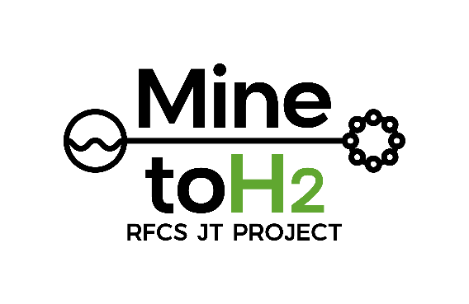








MINE-TO-H2
Repurposing a former coal mine: Green hydrogen for the transport sector using the circular economy and coupled with the heating sector
Coordinator: Alicja Krzemień. Central Mining Institute - National Research Institute (GIG-PIB)
Call:​ RFCS-2023-JT
Start date:​ 01/04/2024
End date:​ 30/09/2028
Total costs: 18 052 926 €

Slide 2

Problem identification
The European Green Deal is supported by the Fit for 55 package, which states that all Union actions and policies, including the RFCS, should pull together to help the Union achieve a successful and just transition towards a sustainable future.
Hydrogen production and its coupling with the heating sector is an excellent option to support the just transition of the coal sector and regions most affected by the transition by repurposing end-of-life coal mines and developing a power sector based mainly on renewable energies.
Hydrogen can be used as a fuel, an energy carrier or a feedstock and could reduce emissions in hard-to-abate sectors, particularly in industry and transport.
Notes:
To ensure the accessibility of this presentation to blind users who use a screen reader,
if you translate this presentation or include parts not in English, make sure the proofing language is set to the right one (Review > Language > Set proofing Language). This will make sure the screen reader uses the right pronunciation.

Slide 3
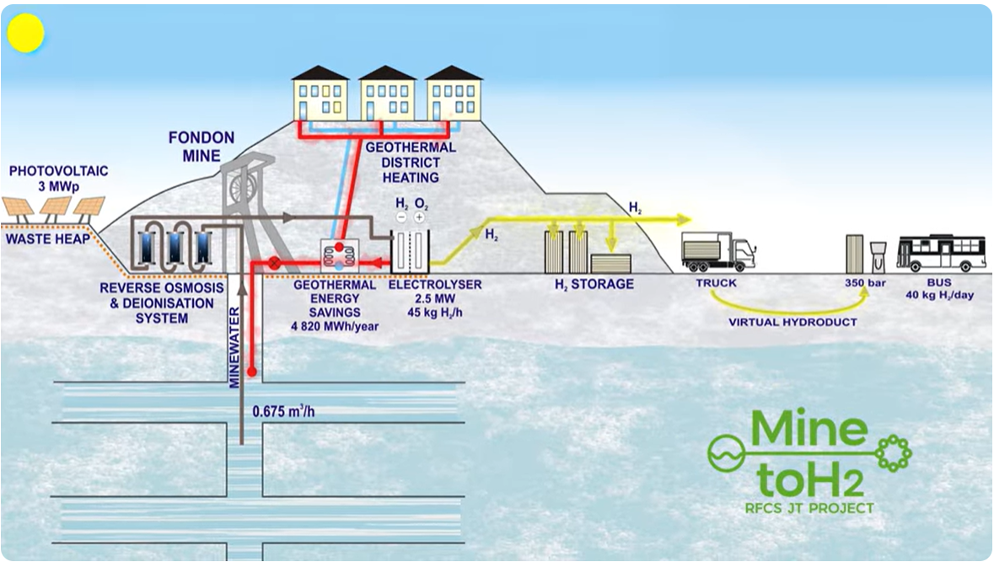
Project overview
The use of mine water for electrolysis to save water from the population supply, and PV from waste heaps.
Achieving energy savings in geothermal district heating through heat recovery by electrolyser cooling.
Demonstrating green H₂ plants economics.
Training and re-skilling of former coal miners.
While TRL 4 is the first step in determining whether the individual components (TRL 9) will work together as a system, the project will bring the system technology to TRL 8.
Notes:
To ensure the accessibility of this presentation to blind users who use a screen reader,
if you translate this presentation or include parts not in English, make sure the proofing language is set to the right one (Review > Language > Set proofing Language). This will make sure the screen reader uses the right pronunciation.

Slide 4
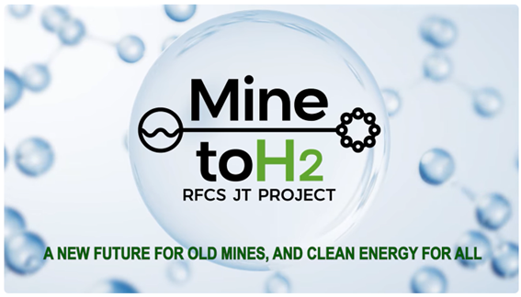
Project overview
https://youtu.be/mYJsP5SgdvA?si=bNxD5QFb3gA8H5uj
Notes:
To ensure the accessibility of this presentation to blind users who use a screen reader,
if you translate this presentation or include parts not in English, make sure the proofing language is set to the right one (Review > Language > Set proofing Language). This will make sure the screen reader uses the right pronunciation.

Slide 5
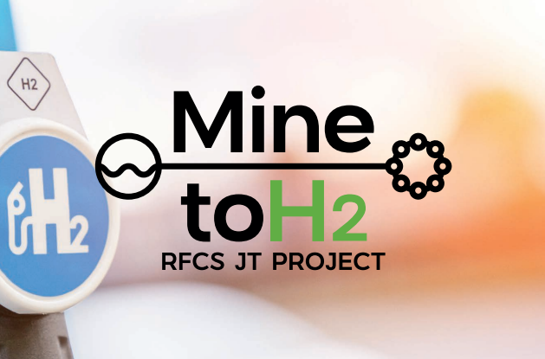
Project results
An operating green hydrogen plant.
Hybridisation with an existing geothermal plant.
Installation of a PV plant in a former coal open-pit mine.
An operating storage and distribution facility for H₂ at 500 bar.
An operating virtual hydroduct and hydrogen refuelling station (HRS), and two prototypes of intercity H₂ buses: Fuel Cell Electric Vehicle & Internal combustion.
Training and reskilling programs to address the skill gaps of former coal mining workers.
Notes:
To ensure the accessibility of this presentation to blind users who use a screen reader,
if you translate this presentation or include parts not in English, make sure the proofing language is set to the right one (Review > Language > Set proofing Language). This will make sure the screen reader uses the right pronunciation.

Slide 6
Project impact​
Alignment with EU Priorities:
The European Green Deal Communication, presented by the European Commission in December 2019, gives some targets to be considered within the coal-related RFCS proposals. These targets are addressed by MINE-TO-H2, thus contributing to achieving a Just Transition towards a climate-neutral economy:
A power sector must be developed based mainly on renewable sources, complemented by the rapid phasing out of coal, by deploying emerging renewable energy.
Focus on the regions and sectors most affected by the transition because they depend on fossil fuels or carbon-intensive processes by repurposing end-of-life coal mines.
Protect people and workers most vulnerable to the transition, providing access to re-skilling programmes and jobs in new economic sectors by promoting sustainable economic growth.
Notes:
To ensure the accessibility of this presentation to blind users who use a screen reader,
if you translate this presentation or include parts not in English, make sure the proofing language is set to the right one (Review > Language > Set proofing Language). This will make sure the screen reader uses the right pronunciation.

Slide 7
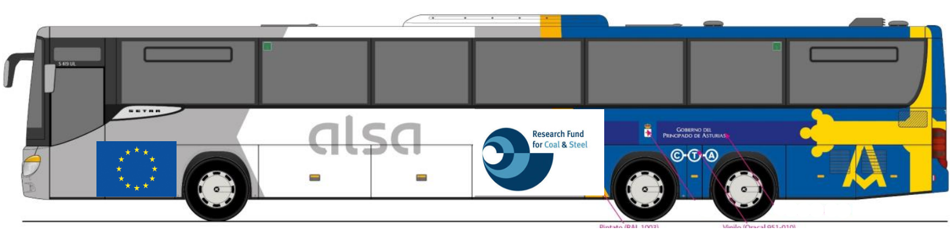
Project impact​
Environmental: Lower climate impact of passenger transport by road, and decarbonisation in processes where electrification and other solutions are not available.
Economic: Increased refuelling efficiency, leading to a more than 95% reduction in refuelling time compared with electric vehicles, and increasing the energy efficiency of systems near green hydrogen plants by incorporating heat recovery from the electrolysers.
Technological: Avoiding other complementary cooling systems for the Electrolyser as Aerocondensers, and a leap towards developing intercity coaches, using the same 350 bar infrastructure as city buses.
Notes:
To ensure the accessibility of this presentation to blind users who use a screen reader,
if you translate this presentation or include parts not in English, make sure the proofing language is set to the right one (Review > Language > Set proofing Language). This will make sure the screen reader uses the right pronunciation.

Slide 8
Lessons learnt​
The Ministry for Ecological Transition and the Demographic Challenge (MITECO) has granted Hunosa the concession to use water from the La Nalona mine in the Fondón well to produce green hydrogen (October 2024).
The Principality’s Department of Mobility, Environment and Emergency Management has given the go-ahead to the project by approving the “strategic environmental assessment” contained in the document, so that it will not be necessary to carry out a full environmental impact assessment, which would require more time (June 2025).
The Integrated Environmental Authorisation (IEA) can be processed now, as the “basic engineering” was already completed. Delays in its completion mean that, as of 30 September 2025, the aforementioned environmental processing has not yet begun, although no further delays are anticipated.
Permission to access and connect to the electricity grid for the renewable hydrogen plant has been requested and authorised, including the project for the installation of high-voltage electrical equipment (July 2025).
Notes:
To ensure the accessibility of this presentation to blind users who use a screen reader,
if you translate this presentation or include parts not in English, make sure the proofing language is set to the right one (Review > Language > Set proofing Language). This will make sure the screen reader uses the right pronunciation.

Slide 9
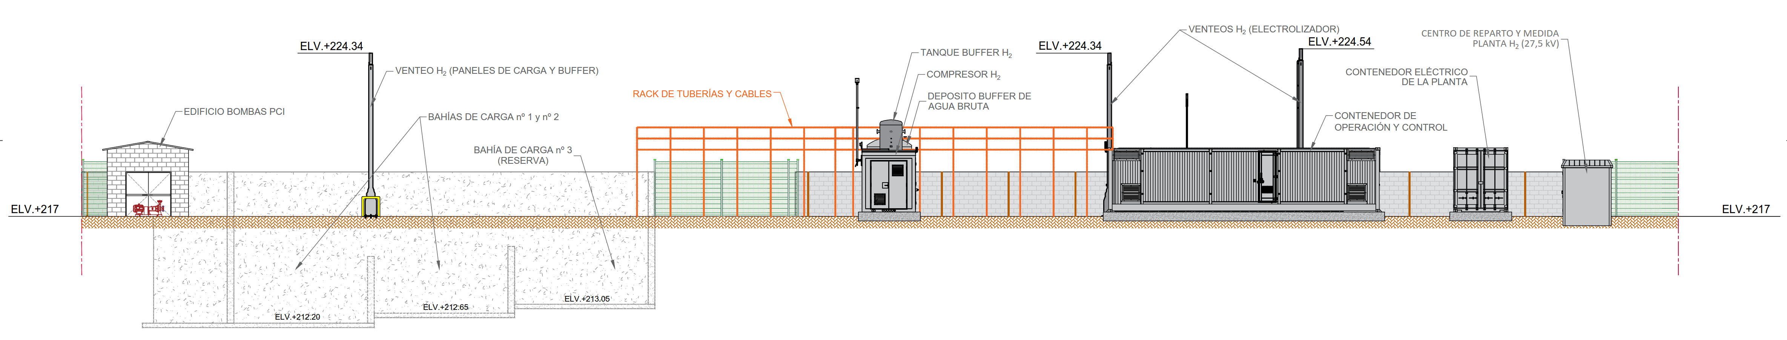
Lessons learnt​
The Langreo City Council has given HUNOSA the final approval to the urban planning modification that will allow the public company to transform the Pozo Fondón de Sama into a green hydrogen plant (February 2026).
It has been decided to develop Basic Engineering in parallel with the start of the Procurement phase. Nevertheless, considering the delivery terms of equipment for the expected dates to put in service the plant, and the long-term negotiations needed for the critical equipment, this task will have a longer duration to select proper suppliers.
Specifications as a base for purchasing were developed, and a request for information to the market for several mechanical equipment and materials was sent: electrolyser, compressor, HRS, H₂ high-pressure loafing panels, heat exchanger, and interconnection piping.
When the Basic Engineering was almost finished, the Detailed engineering started at the beginning of September 2025. At this stage, the Civil works regarding the earth movements advanced.
Notes:
To ensure the accessibility of this presentation to blind users who use a screen reader,
if you translate this presentation or include parts not in English, make sure the proofing language is set to the right one (Review > Language > Set proofing Language). This will make sure the screen reader uses the right pronunciation.

Slide 10
Next steps​
Implementation Roadmap: a common database with potential off-takers in the vicinity of the project has been elaborated to recover the relevant data requested, such as the volume of hydrogen to be consumed, technical & operational supply conditions, and price references to be included in a future MoU–Term sheet.
New Collaborations:
H₂ industry: It has been prioritised for off-takers that currently are consuming hydrogen directly for their own processes, mainly chemical companies and steel manufacturers.
H₂ mobility: Common initiatives have been introduced with different regions at the national level. Further collaborations on mobility solutions have been discussed with the National Centre for Hydrogen, a national reference point for R&D institutions, involved in the technological development and H₂ prototypes, and participating in the H2 LOGIN project to develop a range extender based on green H₂.
Notes:
To ensure the accessibility of this presentation to blind users who use a screen reader,
if you translate this presentation or include parts not in English, make sure the proofing language is set to the right one (Review > Language > Set proofing Language). This will make sure the screen reader uses the right pronunciation.

Slide 11
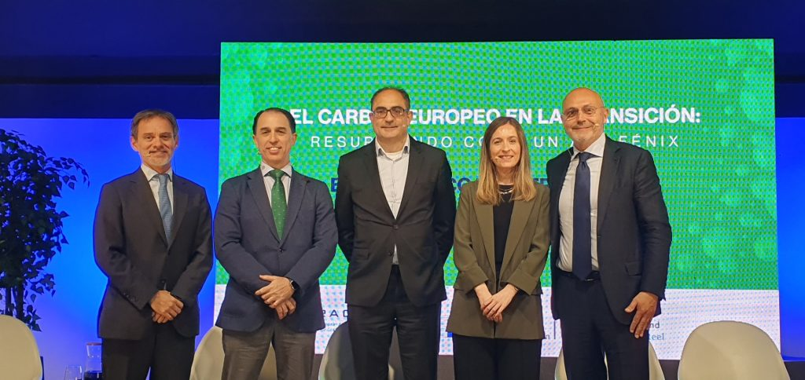
Next steps​
Knowledge Sharing: High-level RFCS Event “European Coal in Transition: rising like a phoenix” organised by MINE-TO-H2, EURACOAL and the European Commission’s Research Executive Agency (REA) (Pozo Sotón, Oviedo, Spain, 8 May 2024).
Notes:
To ensure the accessibility of this presentation to blind users who use a screen reader,
if you translate this presentation or include parts not in English, make sure the proofing language is set to the right one (Review > Language > Set proofing Language). This will make sure the screen reader uses the right pronunciation.

Slide 12
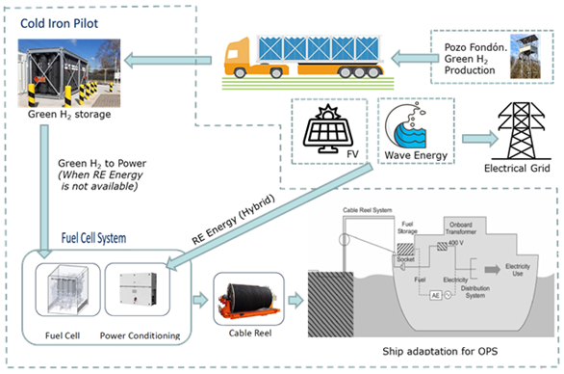
Towards industrial application​s
Potential applications beyond project targets: Exploring further pilots trying to involve other possible stakeholders, e.g., Onshore power supply (OPS).
Pathway to scalability and reproducibility: Contacting potential off-takers: regional and national bus fleets, urban bus fleets, waste management fleets, retail and logistic fleets, industrial plants and others.
Intellectual property strategy: A Consortium Agreement was signed to manage (amongst other things) the ownership and access to crucial knowledge: intellectual property rights (IPR), research data, etc.
Notes:
To ensure the accessibility of this presentation to blind users who use a screen reader,
if you translate this presentation or include parts not in English, make sure the proofing language is set to the right one (Review > Language > Set proofing Language). This will make sure the screen reader uses the right pronunciation.

Slide 13
Thank you for your attention!
Pedro Riesgo Fernández, University of Oviedo
13

