Slide 1






From GreenJOBS to MINE-TO-H₂
Transforming Abandoned Coal Mines into Clean Energy Hubs
Stanisław Prusek, Fasing Group
Alicja Krzemień, GIG-PIB
Jarosław Zagórowski, GIG-PIB
Pedro Riesgo Fernández, UNIOVI

Slide 2

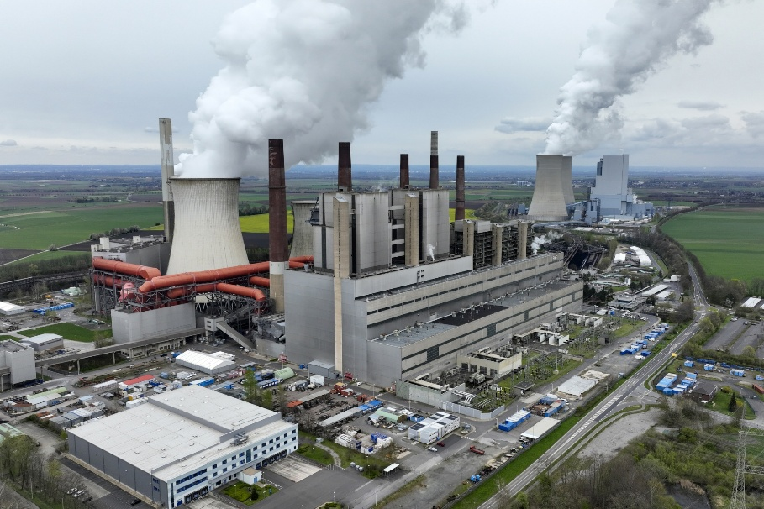
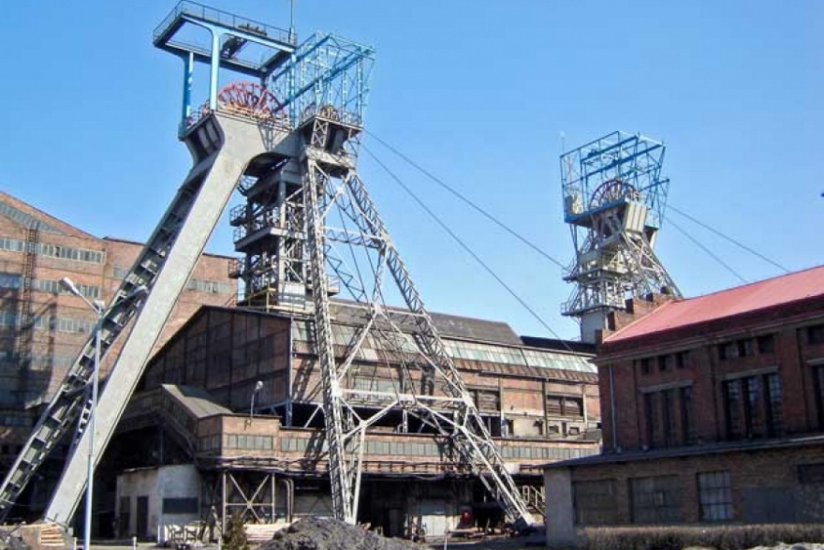
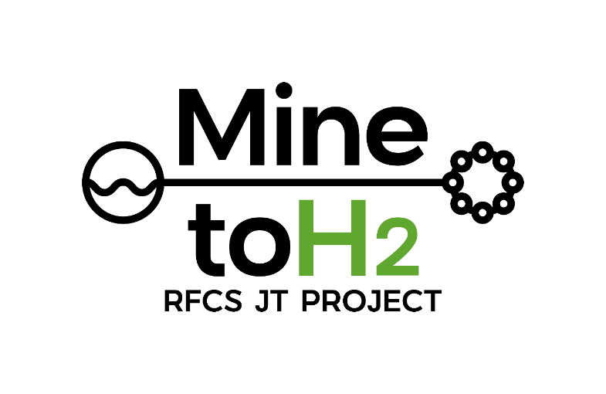
Presentation outline
Profile of the Energy Sector in Poland.
Basic information on coal mining sector in Europe and Poland.
Overview of the Research Projects: GreenJOBS and Mine-to-H₂

Slide 3
ENERGY SECTOR IN POLAND IN 2024

Slide 4
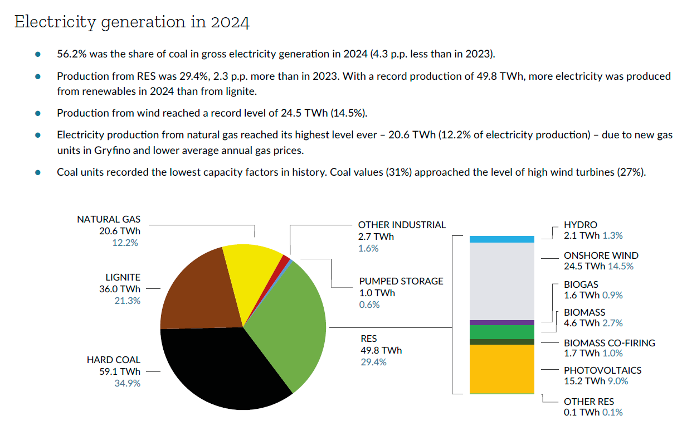
Source: Forum Energii
Notes:
The GreenJOBS project, funded by the EU’s Research Fund for Coal and Steel, asked a simple but powerful question: what if coal mines, instead of being closed and forgotten, could become engines of the clean energy transition?
These mines hold unique assets: water, grid connections, large surface areas, deep shafts, and waste materials.
GreenJOBS set out to transform those assets into opportunities — by deploying renewable energy, circular economy technologies, and, most importantly, by creating new jobs for former miners.
In short, the project aimed to turn a challenge of closure into a new beginning.

Slide 5
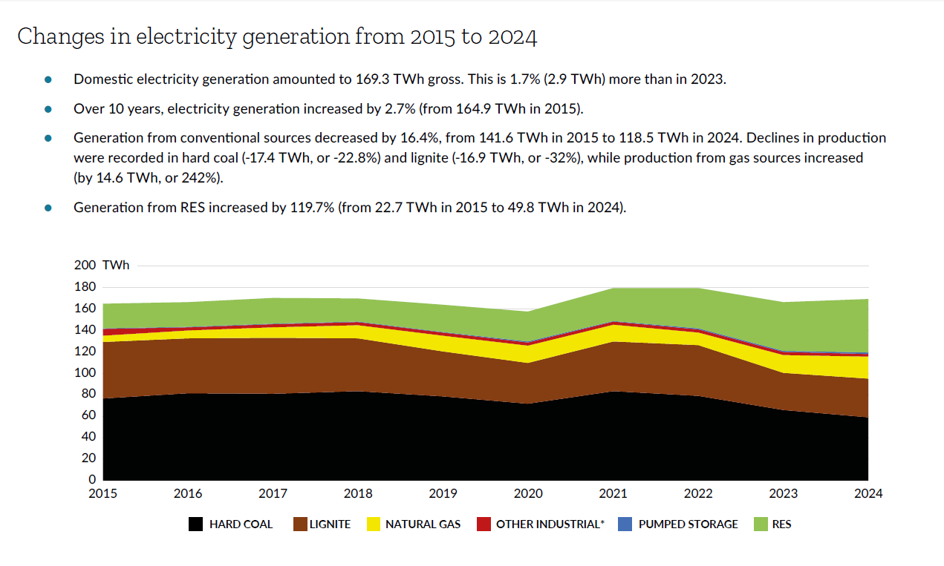
Estimated consumption of steam hard coal fell by 16% (-8.5 million tons) y/y in 2024, to about 36 million tons.
Source: Forum Energii
Notes:
The GreenJOBS project, funded by the EU’s Research Fund for Coal and Steel, asked a simple but powerful question: what if coal mines, instead of being closed and forgotten, could become engines of the clean energy transition?
These mines hold unique assets: water, grid connections, large surface areas, deep shafts, and waste materials.
GreenJOBS set out to transform those assets into opportunities — by deploying renewable energy, circular economy technologies, and, most importantly, by creating new jobs for former miners.
In short, the project aimed to turn a challenge of closure into a new beginning.

Slide 6
BASIC INFORMATION ON COAL MINING SECTOR IN EUROPE AND POLAND

Slide 7
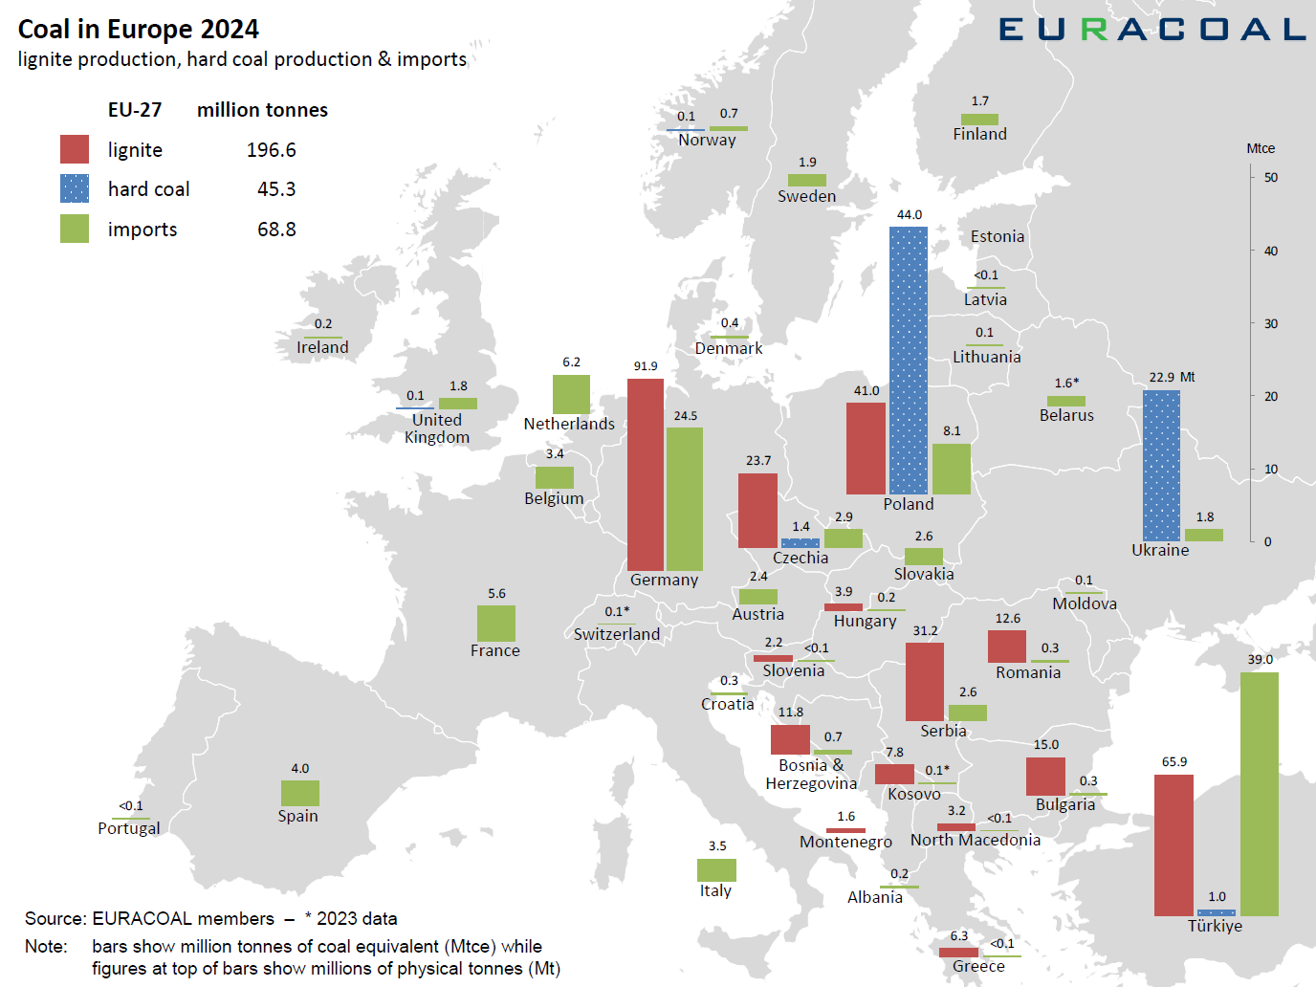
Notes:
The GreenJOBS project, funded by the EU’s Research Fund for Coal and Steel, asked a simple but powerful question: what if coal mines, instead of being closed and forgotten, could become engines of the clean energy transition?
These mines hold unique assets: water, grid connections, large surface areas, deep shafts, and waste materials.
GreenJOBS set out to transform those assets into opportunities — by deploying renewable energy, circular economy technologies, and, most importantly, by creating new jobs for former miners.
In short, the project aimed to turn a challenge of closure into a new beginning.

Slide 8
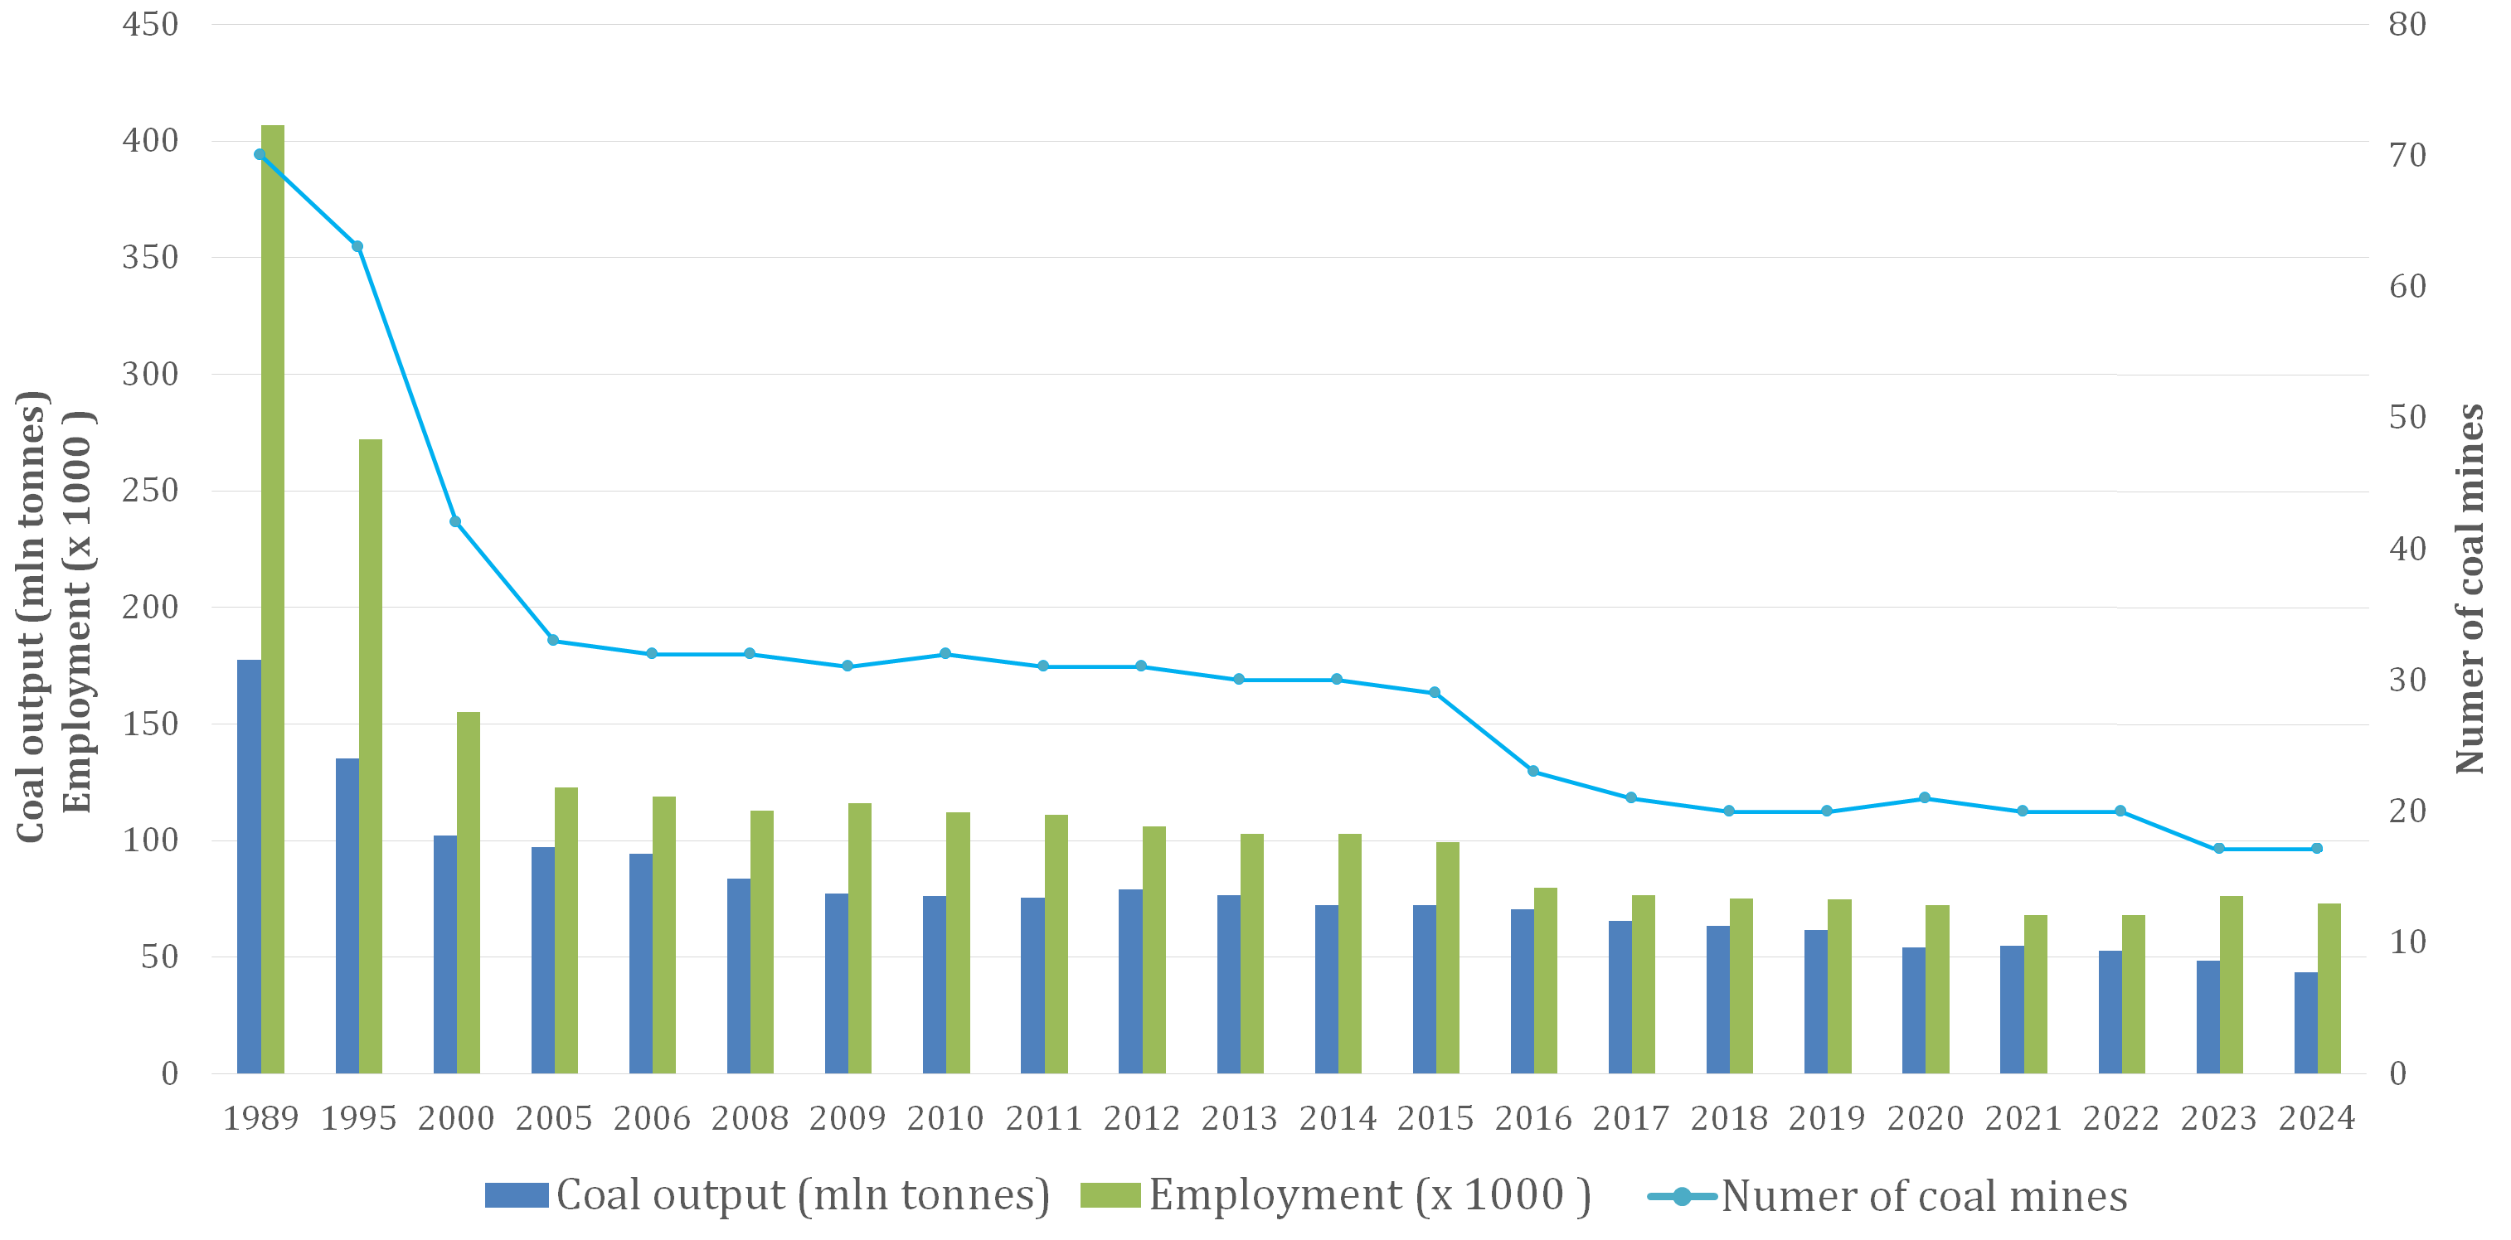
restructuring of the Polish hard coaL mining industry
1989
Coal output – 177 Mt
Employment – 400 thousand people
Number of mines - 70
2024
Coal output – 44 Mt
Employment – 68 thousand people
Number of mines - 19
Employment has fallen by more than five times

Slide 9
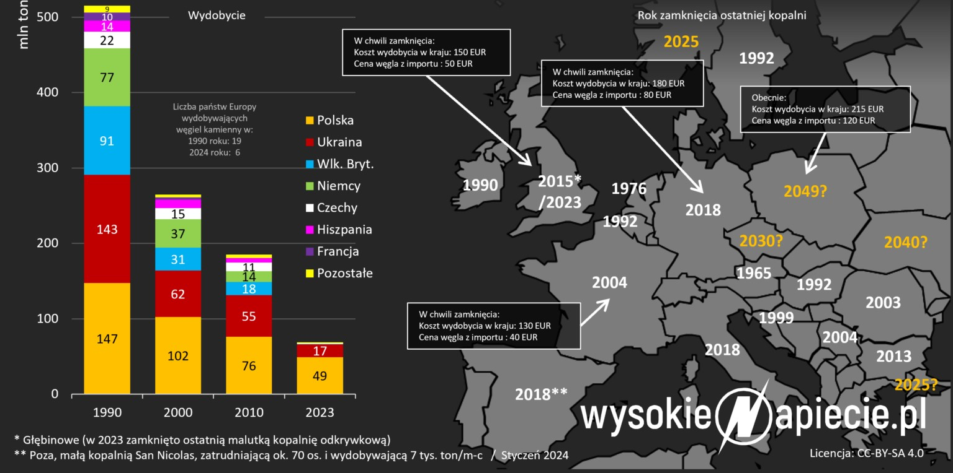
The future of coal mining in Poland
In May 2021, the Polish government signed a deal (social contract) with mining unions to use public funds to support miners during Poland’s phase out of thermal coal by 2049.
This agreement does not include coking coal mines and is currently in the process of notification by the European Commission.
9

Slide 10
RFCS Research Projects
GreenJOBS and Mine-to-H₂

Slide 11

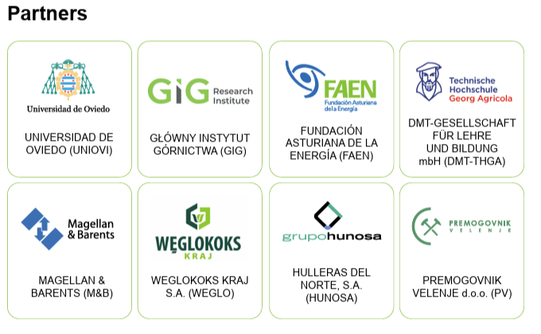









Leveraging the competitive advantages
of end-of-life underground coal mines to maximise the creation of green and quality jobs ……………………………………….. ​
Coordinator: UNIVERSITY OF OVIEDO
Call:​ RFCS-2021
Start date:​ 01/07/2022
End date: 31/12/2025​
Total budget: 2,202,647 €
8 partners from 4 countries

Slide 12

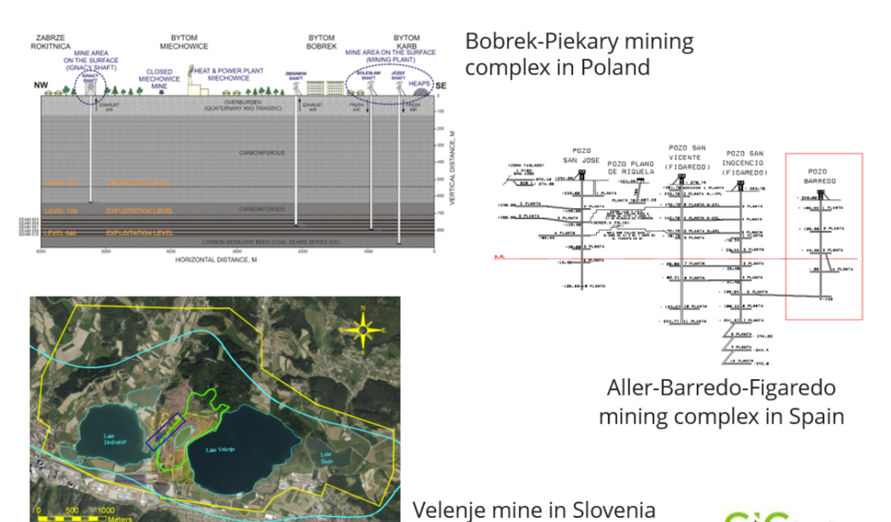
Project sites

Slide 13
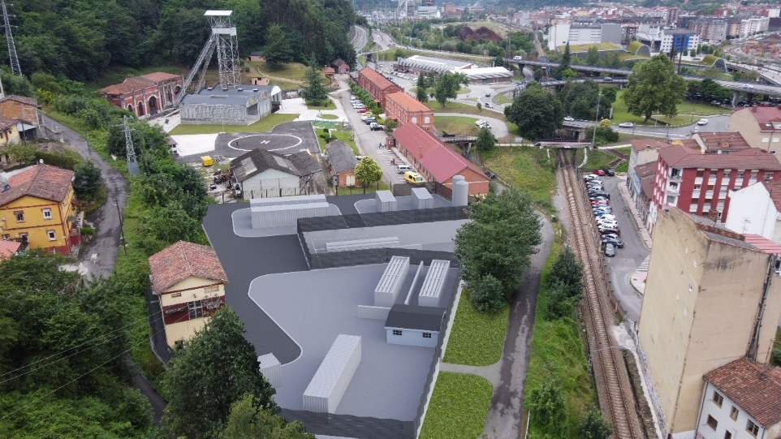
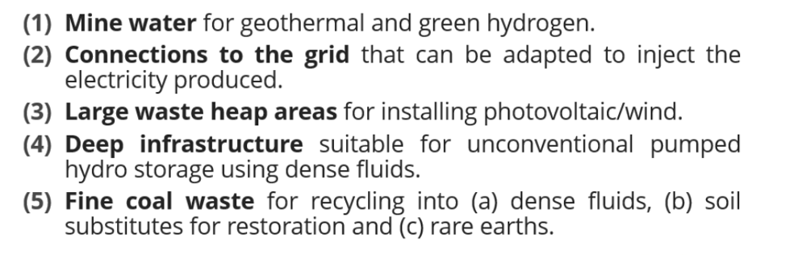
Problems tackled by GreenJOBS
Before GreenJOBS, there was no guidance focused on operating underground coal mining companies to understand, evaluate, design, and implement alternative economic activities within their future closing period.
There were no studies on repurposing end-of-life underground coal mines, leveraging their competitive advantages:
Notes:
We also highlighted something that had been overlooked: coal mines are not empty shells.
They offer valuable infrastructure and resources.
Mine water can support geothermal or hydrogen production, grid connections are already in place, waste heaps can host solar or wind, deep shafts can become reservoirs for energy storage, and coal residues can even be recycled.
By recognising these strengths, GreenJOBS shifted the debate: from what do we lose with closure to what can we gain.

Slide 14
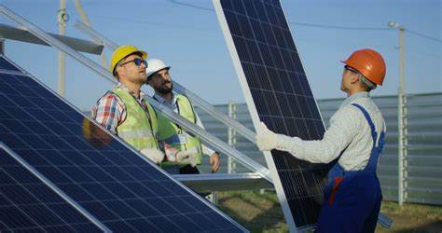
Main objectives
The project has two main goals.
First, to prepare business plans showing how mining companies could realistically deploy renewable energy and circular economy technologies.
Second, to develop training and re-skilling programmes, ensuring that former miners were not left behind but could take part in this transformation.
Notes:
The project set itself two clear goals.
First, to prepare business plans showing how mining companies could realistically deploy renewable energy and circular economy technologies.
Second, to develop training and re-skilling programmes, ensuring that former miners were not left behind but could take part in this transformation.
This dual focus — technology and people — was the essence of GreenJOBS.

Slide 15
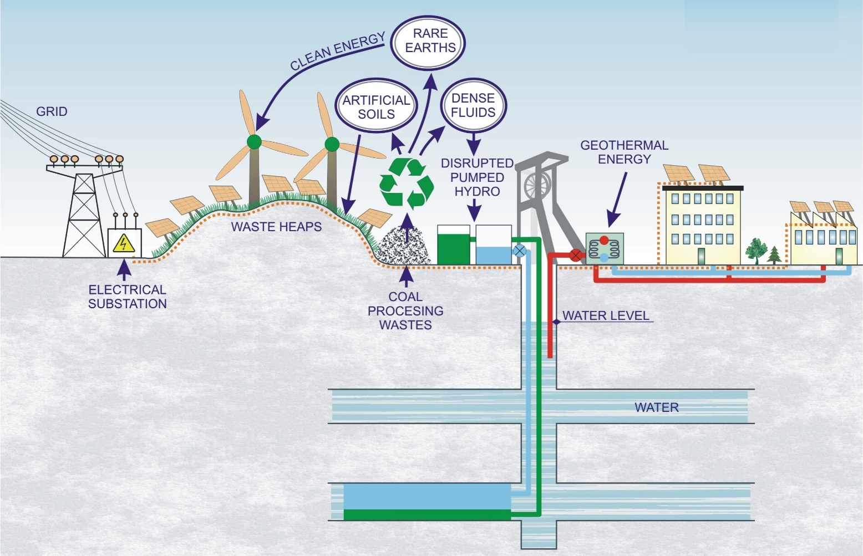
Main results
Two innovative business plans:
  Virtual Power Plant where the energy locally produced will be sold to the grid or used to power electro-intensive industries or companies with constant energy consumption close to mines, such as aluminium factories or green data centers.
Notes:
One of our flagship outcomes was the concept of a Virtual Power Plant.
It is not a single facility, but a digital platform that integrates different renewable sources and manages them as one.
Energy produced locally can be fed into the grid or supplied to nearby industries, making coal regions active producers of clean energy.
This model demonstrates how traditional mining areas can remain central to Europe’s energy landscape — even without coal.

Slide 16
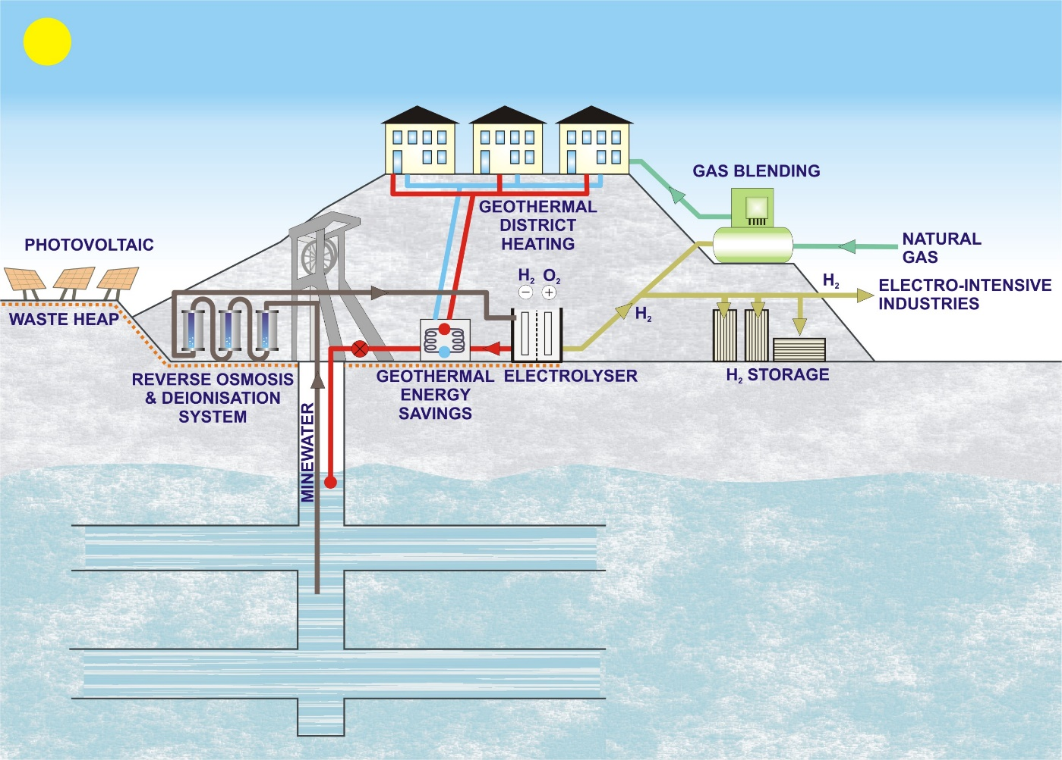
Main results
  Green Hydrogen Plant where renewable hydrogen will be produced by electrolysis of mine water and green electricity.
Notes:
The second flagship result was a plan for a Green Hydrogen Plant.
Here, hydrogen is produced by electrolysis of mine water using renewable electricity.
This approach is symbolic: the same water that once flooded galleries can now drive the energy transition.
Hydrogen is flexible — it stores energy, fuels transport, and serves industry.
With this concept, GreenJOBS laid the foundation for the demonstration project that followed: Mine-to-H₂.

Slide 17
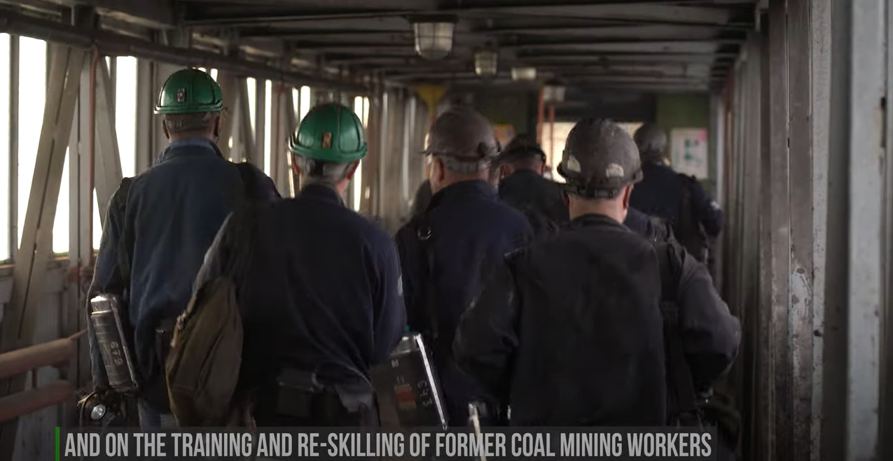
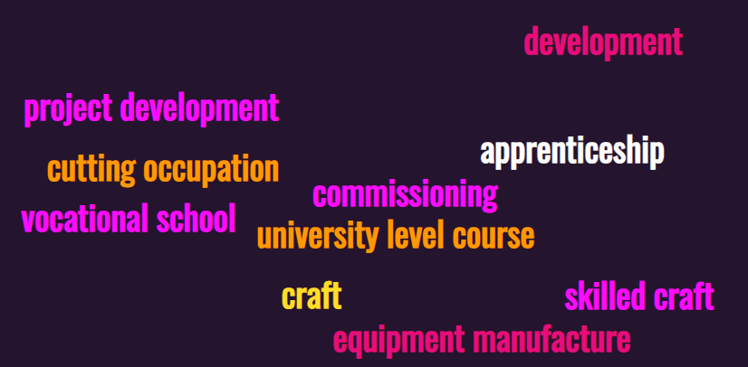
Main results
Within the project, training courses for miners have been developed to support their reskilling and help them find employment in new sectors, such as renewable energy, hydrogen production, or waste processing.
Notes:
No transition can succeed without people.
That is why GreenJOBS also delivered training and re-skilling programmes, adapted to different levels of expertise.
These programmes addressed skill gaps and prepared former miners for jobs in renewables, hydrogen, or circular economy sectors.
In this way, the project directly supported the idea of a just transition — a transition that creates opportunities for those most affected.

Slide 18
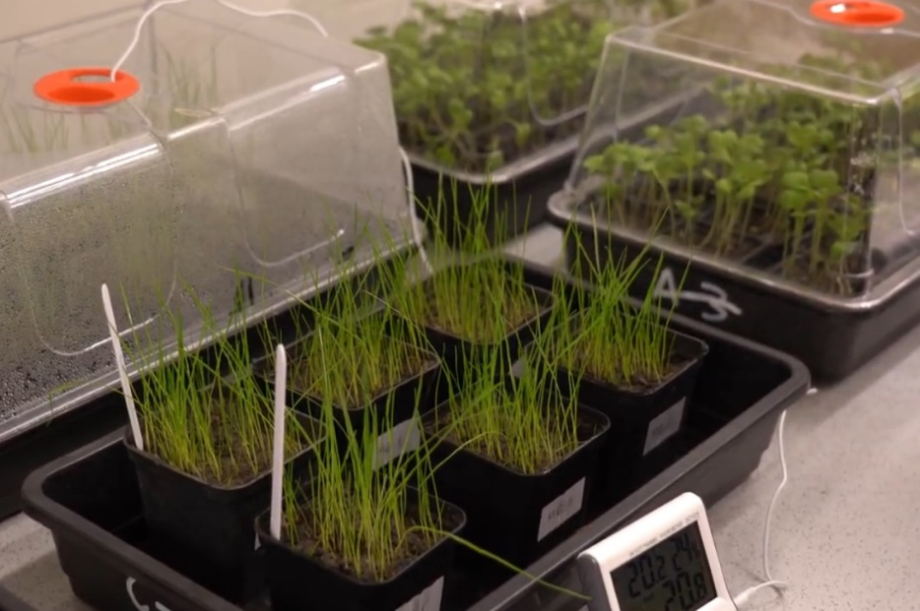
Circular economy technologies
  Another important part of the project focused on circular economy solutions for coal waste.
  Three areas were researched:
  producing soil substitutes to rehabilitate waste heaps before installing renewable energy plants,
  developing dense fluids for unconventional pumped hydro storage,
  and investigating the recovery of rare earth elements.
Notes:
Another distinctive part of the project was the focus on circular economy solutions for coal waste.
We tested three innovations: producing soil substitutes to rehabilitate waste heaps before installing renewable plants, developing dense fluids for unconventional pumped hydro storage, and investigating rare earth recovery.
The message is clear: even waste, when combined with science, can become a resource.

Slide 19
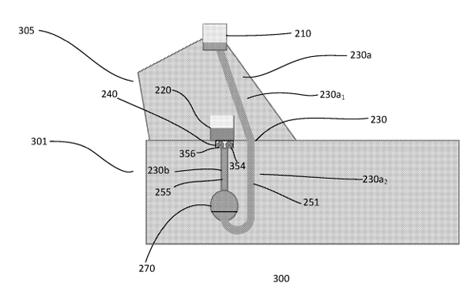

Dense fluids
Dense fluids are liquids with much greater density than typical fluids (eg. water), used for specialized technical applications such as energy storage.
Experimental tests consisting of fluid-dynamic and rheology analysis showed that developing dense fluids with coal waste from the Spanish and Slovenian mines is feasible.
Poland and Spanish patents EP 3 768 967 on a “Pumped Hydro Energy Storage System and Method” were granted in 2024 to Magellan & Barents, partner of the GreenJOBS Project, to support the adoption of Unconventional pumped hydro storage by Polish and Spanish mining companies interested in this energy storage alternative within the exploitation plan of the GreenJOBS Project.
Notes:
The dense fluids idea is particularly innovative.
Instead of relying on large reservoirs, pumped hydro in mining areas can use underground spaces and engineered fluids.
Experiments in Spain and Slovenia confirmed the feasibility of this concept.
It is a creative way to give a second life to mining voids, turning them into assets for energy storage.
Poland’s coal waste was not suitable, but the approach proved that unconventional storage is possible.

Slide 20
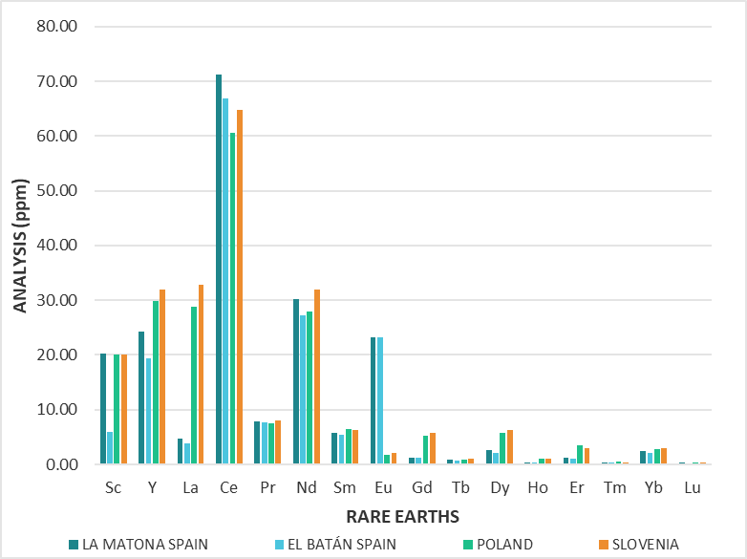
Recovery of REE
Within the project, a study was conducted on the content of rare earth elements in mining waste from mines in Poland, Spain, and Slovenia
Rare earth element concentrations in coal waste range from 150 to 310 ppm (0.015–0.031%). For a mine to be economically feasible, concentrations between 1 and 2% (10,000–20,000 ppm) are required. This indicates that the amount of rare earth elements present in the waste heaps of the three studied countries (ES, PL, SI) is too low to be economically feasible."
Notes:
We also examined whether rare earth elements could be recovered from coal waste.
These are strategic materials for Europe’s clean technologies.
Our analysis showed measurable concentrations, but they were too low — far below the threshold for economic mining.
This finding was important: sometimes innovation means recognising where opportunities do not exist.

Slide 21
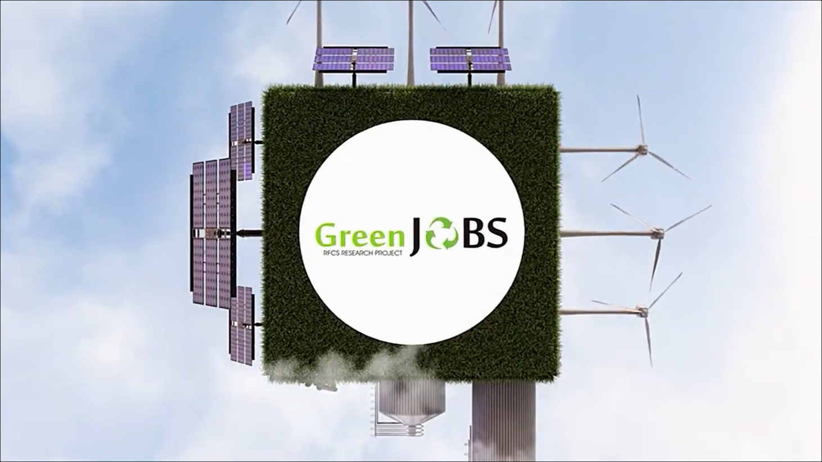
GreenJOBS video
https://urldefense.com/v3/__https://www.youtube.com/watch?v=o2sngsLmjwY__;!!D9dNQwwGXtA!R7pD3Fhe2l0YQOJiaYU4QCuZW4GpnnWNrBxiDTkmYFh50XvQ5MBZ7TsEKpumTLliL8klEl0LdsNTW_oZq1U$
Notes:
To make our results accessible, GreenJOBS also produced a video.
It shows how post-mining regions can be revitalised and how communities can benefit.
Communication is essential. People need to see that the transition is not just abstract policy but something real and beneficial for their region.

Slide 22

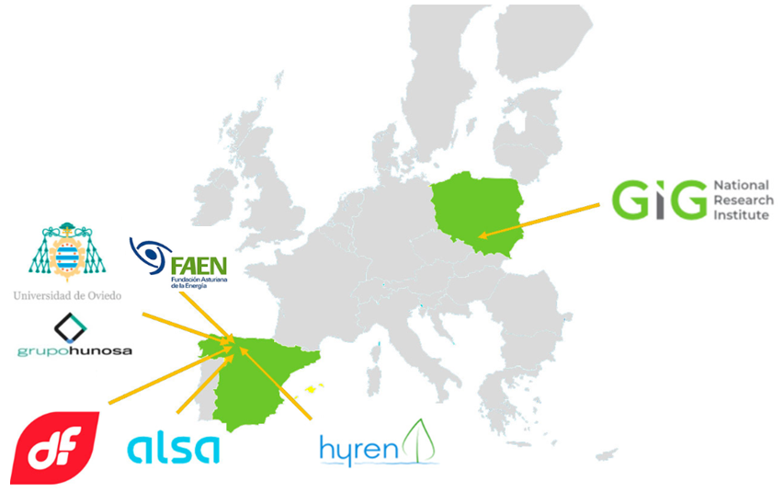
Mine-to-H₂ Project
Mine-to-H₂: Repurposing a former coal mine: Green hydrogen for the transport sector using the circular economy coupled with the heating sector
Call: RFCS-2023-JT
Instrument: PDR
Start date: 01/04/2024
End date: 30/09/2028
Budget: 18,052,926 €
Notes:
This slide introduces the Mine-to-H₂ project, which is the continuation of GreenJOBS.It was launched in April 2024 and will run until September 2028, with a budget of over 18 million euros.The project is coordinated by the University of Oviedo, with strong participation from partners in Spain and Poland, including GIG.Its goal is to build and operate a green hydrogen plant in a former coal mine, demonstrating how hydrogen can support clean transport and heating.Together, these partners are showing how ideas developed in GreenJOBS can now be put into practice on an industrial scale.

Slide 23
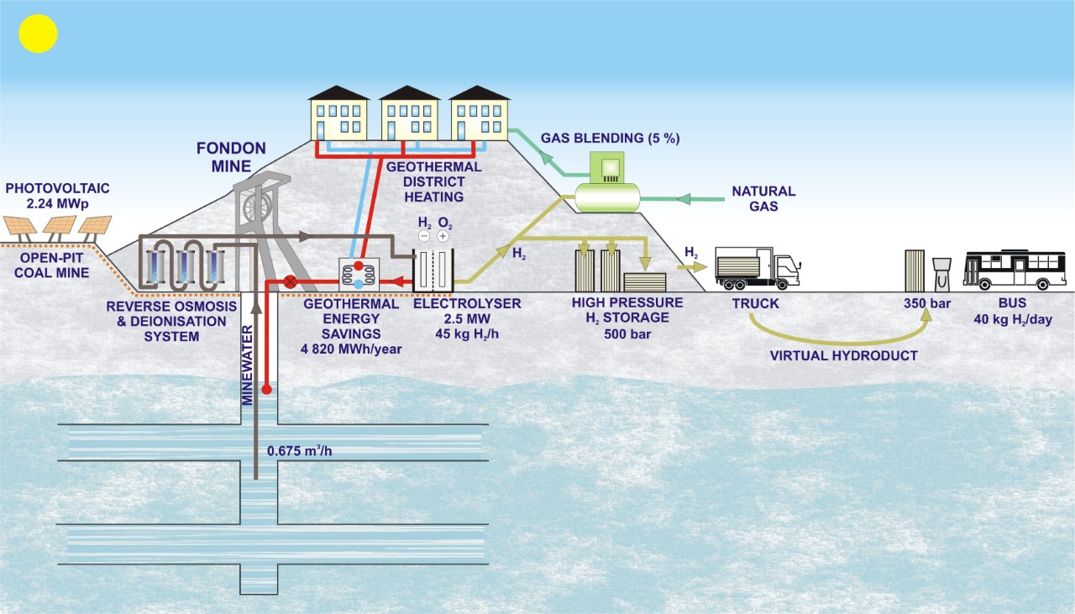
Main objectives
The use of mine water for electrolysis to save water from the population supply.
H₂ injection into natural gas grids, refueling and storage.
Demonstrating the economics of green hydrogen plants.
Training and re-skilling of former coal miners.
Achieving energy savings in geothermal district heating through heat recovery by electrolyser cooling.
Notes:
The objectives of Mine-to-H₂ are ambitious but clear.
We will use mine water for electrolysis, preserving fresh water supplies.
We will explore hydrogen blending into gas grids, develop refuelling stations, and test storage technologies.
And just as in GreenJOBS, we will continue to train and re-skill workers, ensuring that this innovation benefits people as well as the planet.

Slide 24
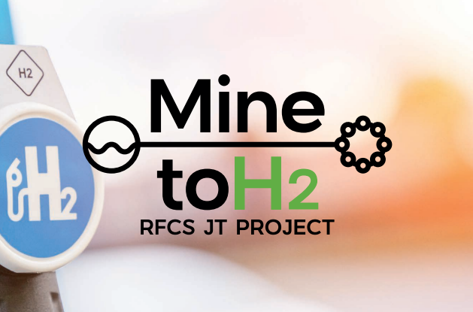
Main expected results
An operating green hydrogen plant.
Hybridization with an existing geothermal plant.
Installation of a photovoltaic plant in a former coal open-pit mine.
An operating storage and distribution facility for hydrogen at 500 bar.
An operating virtual hydroduct and hydrogen refueling station (HRS), and a prototype of intercity hydrogen bus (Fuel Cell Electric Vehicle).
Injection of hydrogen to the natural gas network.
Training and reskilling programs to address the skill gaps of former coal mining workers.
Notes:
The project will deliver very tangible outcomes.
We will see a functioning hydrogen plant, hybridised with geothermal energy.
We will build a photovoltaic installation on a former open-pit coal mine.
Hydrogen will be compressed to 500 bar, distributed via a virtual hydroduct, and used in a refuelling station.
And importantly, a hydrogen-powered intercity bus will be tested in real conditions, thanks to our collaboration with CaetanoBus and Toyota.

Slide 25
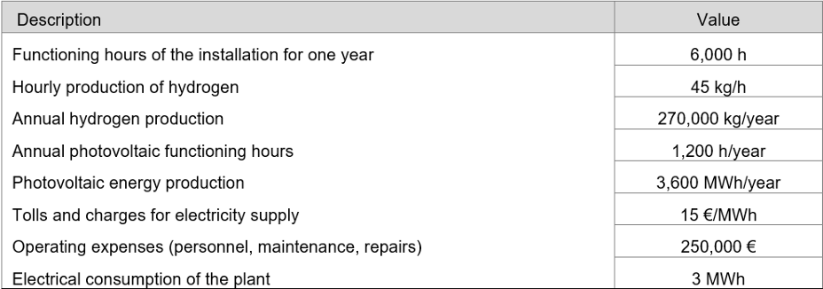
Technical and economic parameters
Notes:
We are already engaging with potential users: bus fleets, logistics companies, and industrial operators.
We are also exploring new pilots, such as onshore power supply for ports, where hydrogen can reduce emissions from ships at berth.
These partnerships ensure that hydrogen produced in former coal regions will find real, long-term markets.

Slide 26
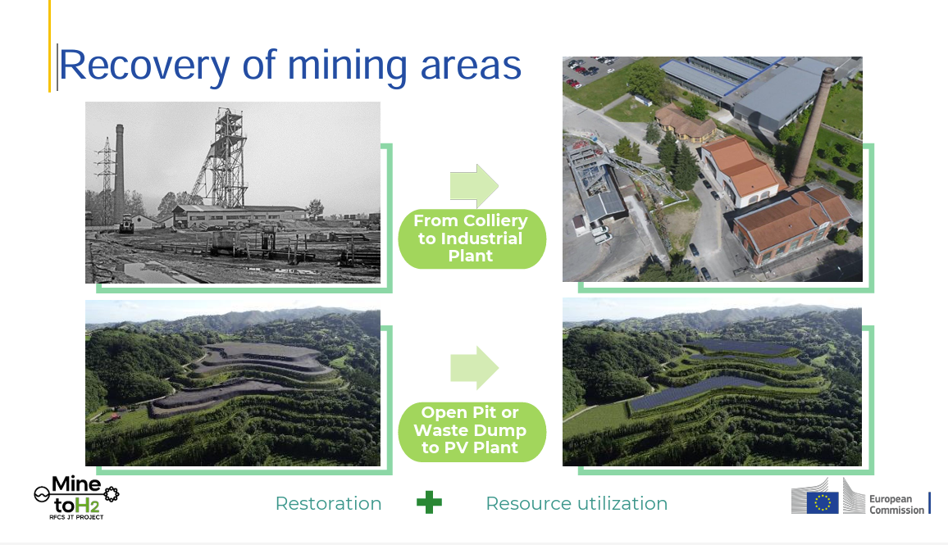
Notes:
We are already engaging with potential users: bus fleets, logistics companies, and industrial operators.
We are also exploring new pilots, such as onshore power supply for ports, where hydrogen can reduce emissions from ships at berth.
These partnerships ensure that hydrogen produced in former coal regions will find real, long-term markets.

Slide 27
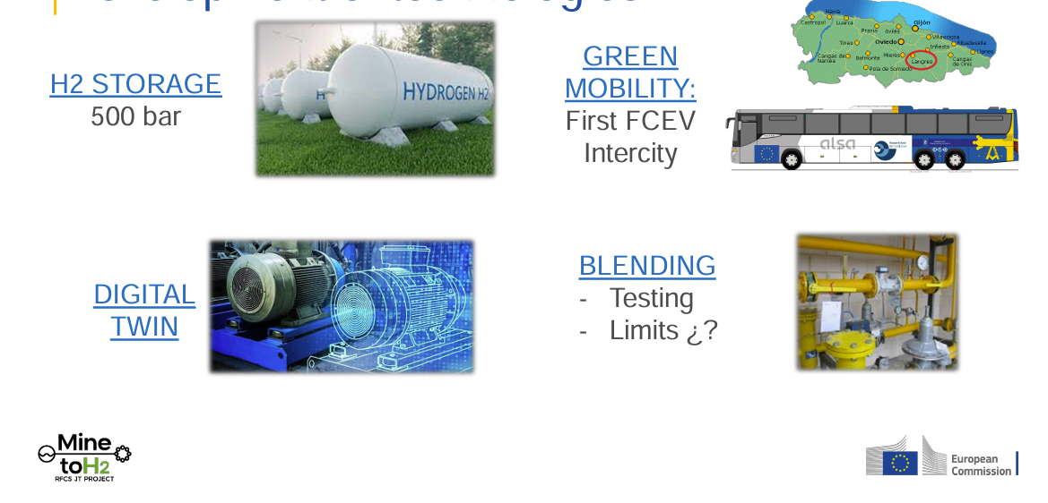
Development of new technologies
Notes:
We are already engaging with potential users: bus fleets, logistics companies, and industrial operators.
We are also exploring new pilots, such as onshore power supply for ports, where hydrogen can reduce emissions from ships at berth.
These partnerships ensure that hydrogen produced in former coal regions will find real, long-term markets.

Slide 28
Mine-to-H₂ video
Notes:
To make our results accessible, GreenJOBS also produced a video.
It shows how post-mining regions can be revitalised and how communities can benefit.
Communication is essential. People need to see that the transition is not just abstract policy but something real and beneficial for their region.

Slide 29


Thank you for your attention!!

