Slide 1

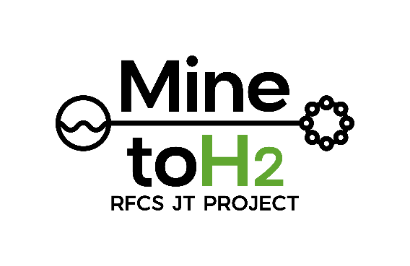
MINE-TO-H2
Feasibility of repurposing former coal mines to produce green hydrogen using circular economy principles.
Gregorio Fidalgo Valverde (UNIOVI)
Fco. Javier Iglesias Rodríguez (UNIOVI)
Antonio Marqués Sierra (UNIOVI)
Pedro Riesgo Fernández (UNIOVI)
Ana Suárez Sanchez (UNIOVI)

Slide 2

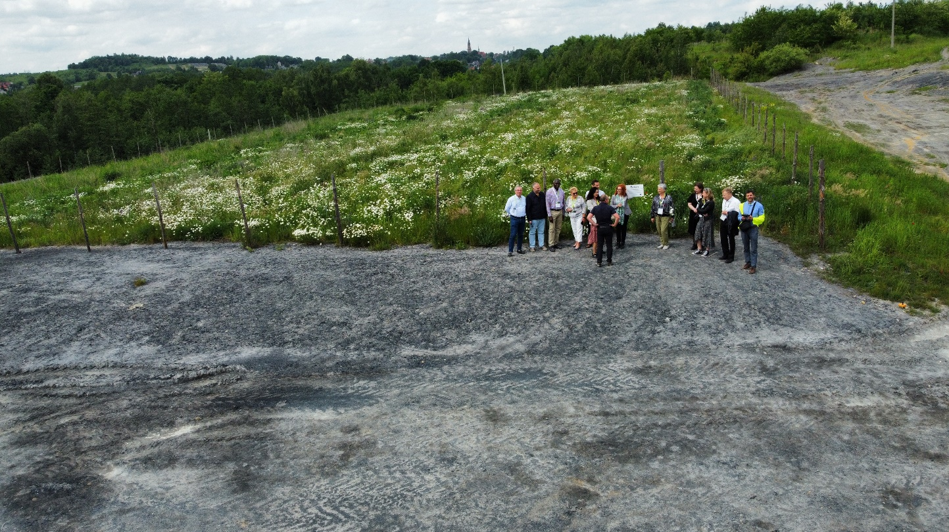
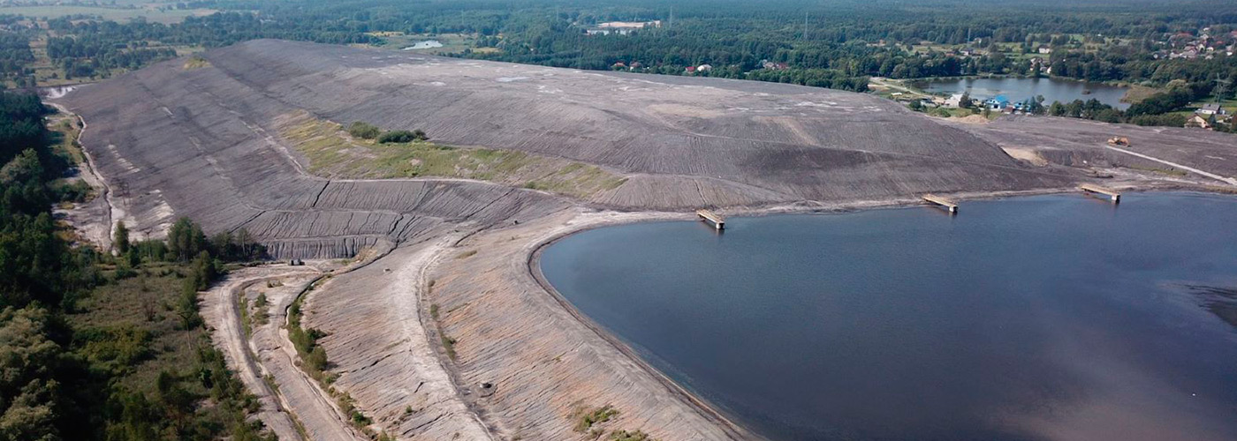
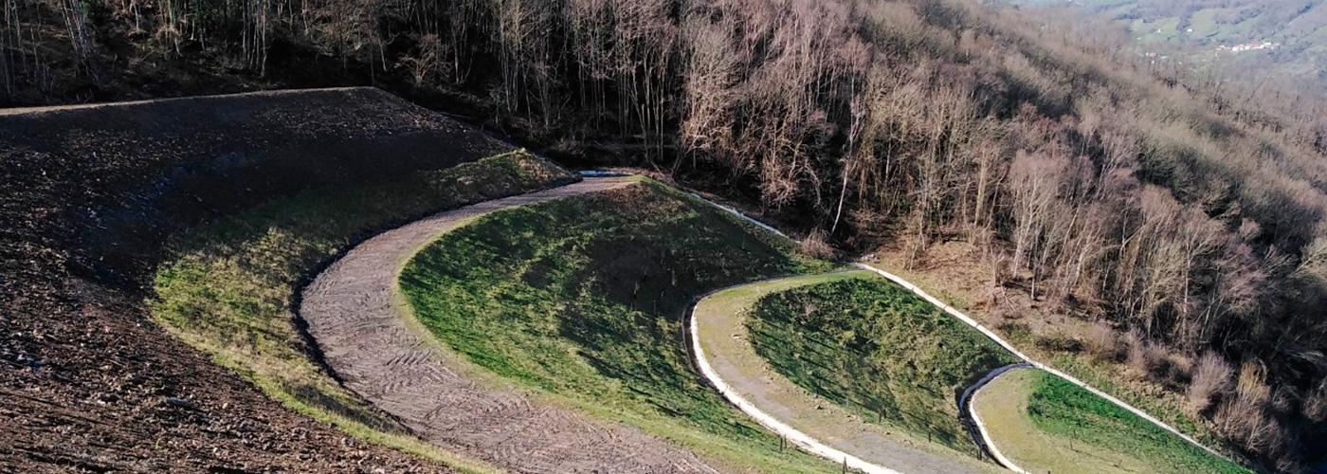

Where do we come from?
Recovery Project developed a framework for land rehabilitation and ecological restoration in areas affected by coal mining, with the aim of accelerating the recovery of degraded and transformed ecosystems to achieve a good ecological status.

Slide 3

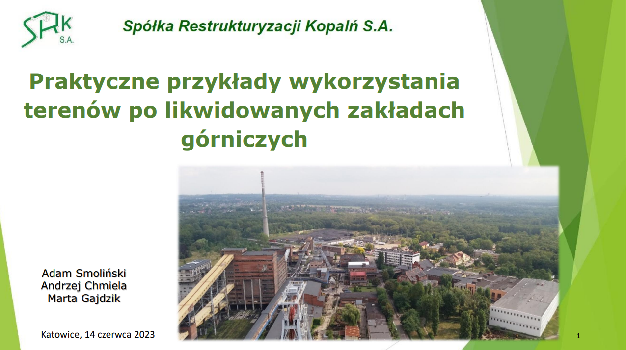
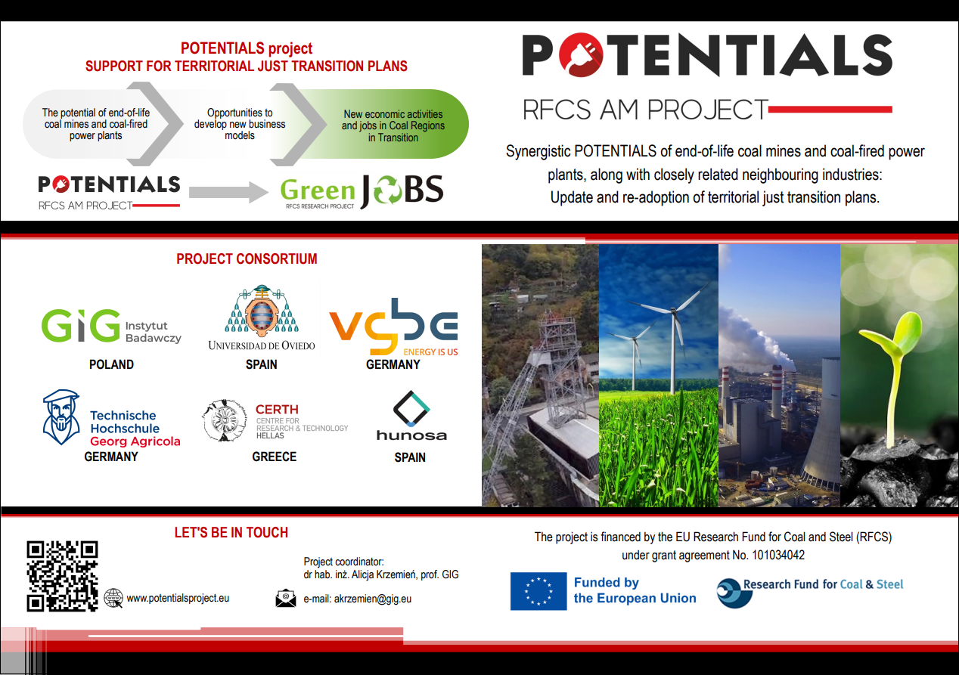

Where do we come from?
Potentials Project identified and assessed synergies through prospective analysis, enabling sustainable business models based on renewable energy, circular economy, and energy storage, while supporting the revision and implementation of territorial just transition plans.

Slide 4

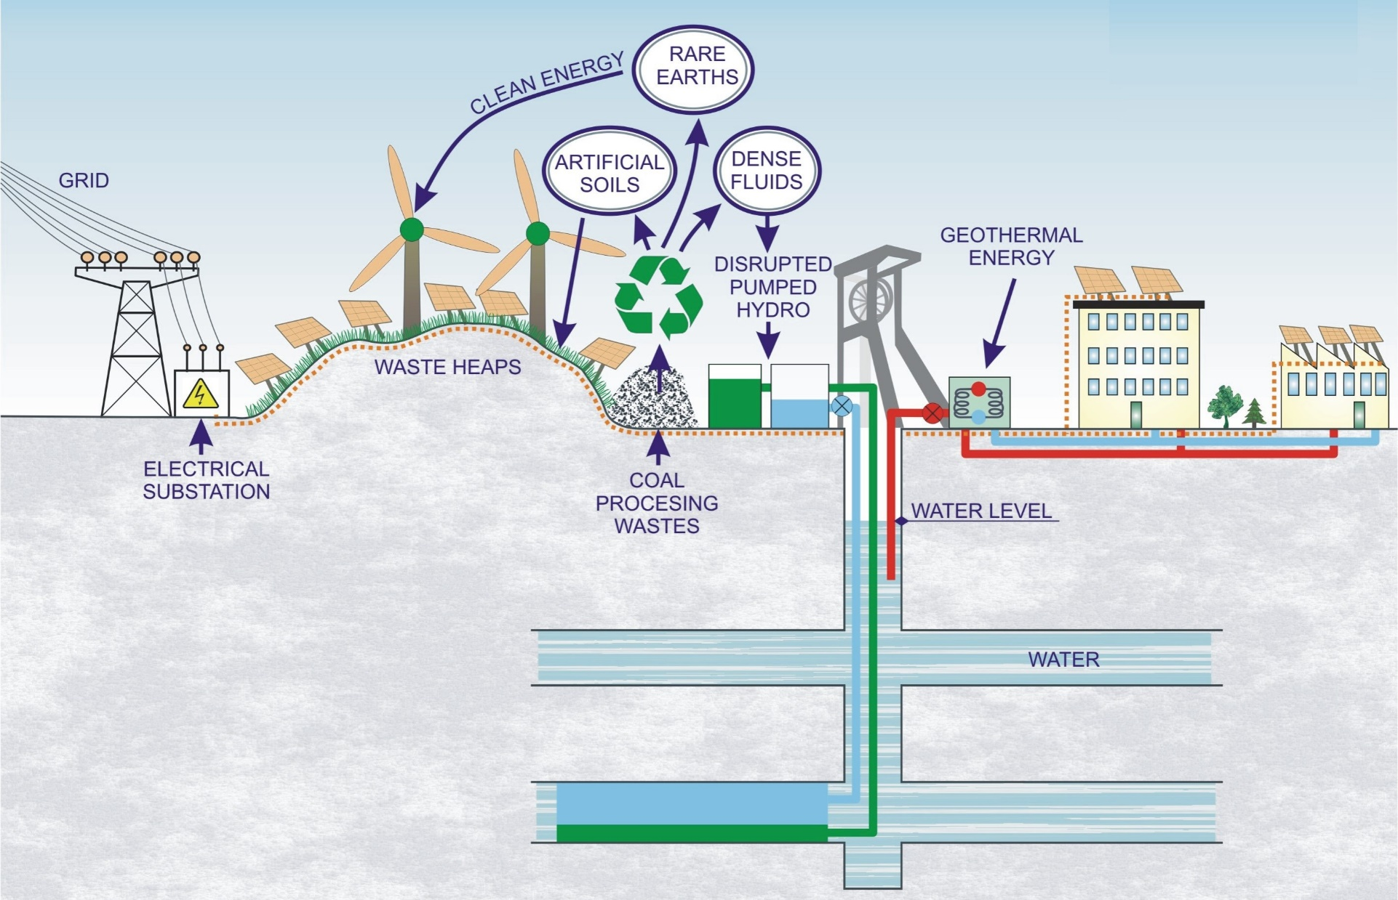
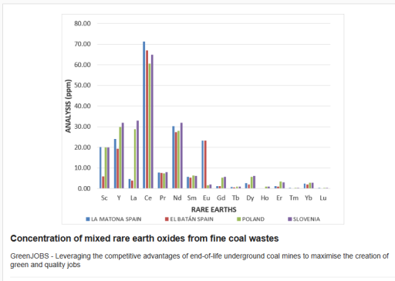
Where do we come from?
GreenJOBS Project aimed to provide mining companies with two innovative business models: a Virtual Power Plant to sell energy to the grid or supply nearby electro-intensive industries, and a Green Hydrogen Plant producing renewable hydrogen via electrolysis using mine water and renewable electricity.

Slide 5






MINE-TO-H2
Feasibility of repurposing former coal mines to produce green hydrogen using circular economy principles.
Big Ticket Project
Call: RFCS-2023-JT
Instrument: PDR
Start date: 01/04/2024
End date: 30/09/2028
Budget: 18 052 926 €

Slide 6

Problem tackled by MINE-TO-H2
The European Green Deal is supported by the Fit for 55 package, which states that all Union actions and policies, including the RFCS, should pull together to help the Union achieve a successful and just transition towards a sustainable future.
Hydrogen production and its coupling with the heating sector is an excellent option to support the just transition of the coal sector and regions most affected by the transition by repurposing end-of-life coal mines and developing a power sector based mainly on renewable energies.
Hydrogen can be used as a fuel, an energy carrier or a feedstock and could reduce emissions in hard-to-abate sectors, particularly in industry and transport.

Slide 7
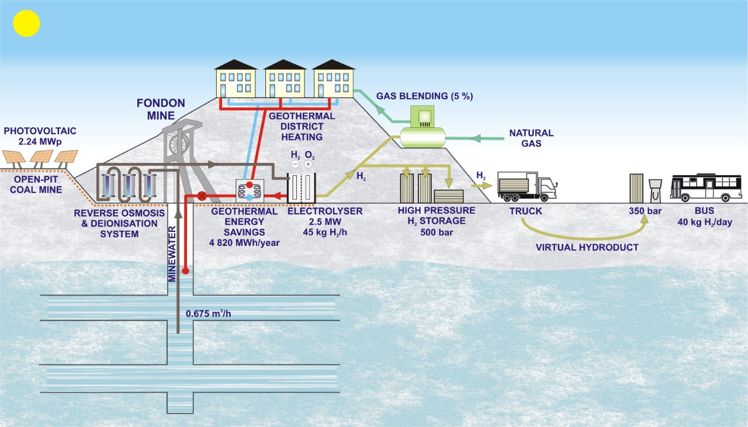
Main objectives
The use of mine water for electrolysis to save water from the population supply.
H₂ injection into natural gas grids, refueling and storage.
Demonstrating the economics of green hydrogen plants.
Training and re-skilling of former coal miners.
Achieving energy savings in geothermal district heating through heat recovery by electrolyser cooling.

Slide 8
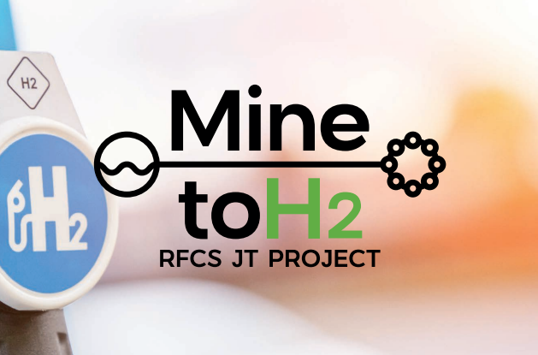
Main expected results
An operating green hydrogen plant.
Hybridization with an existing geothermal plant.
Installation of a photovoltaic plant in a former coal open-pit mine.
An operating storage and distribution facility for hydrogen at 500 bar.
An operating virtual hydroduct and hydrogen refueling station (HRS), and a prototype of intercity hydrogen bus (Fuel Cell Electric Vehicle).
Injection of hydrogen to the natural gas network.
Training and reskilling programs to address the skill gaps of former coal mining workers.
Notes:
data, publications, software, product, service, process, prototype, patent, standard, code of conduct, educational/training material, skills, collaboration platforms, reports, policy recommendations, research roadmaps, research topics, …

Slide 9
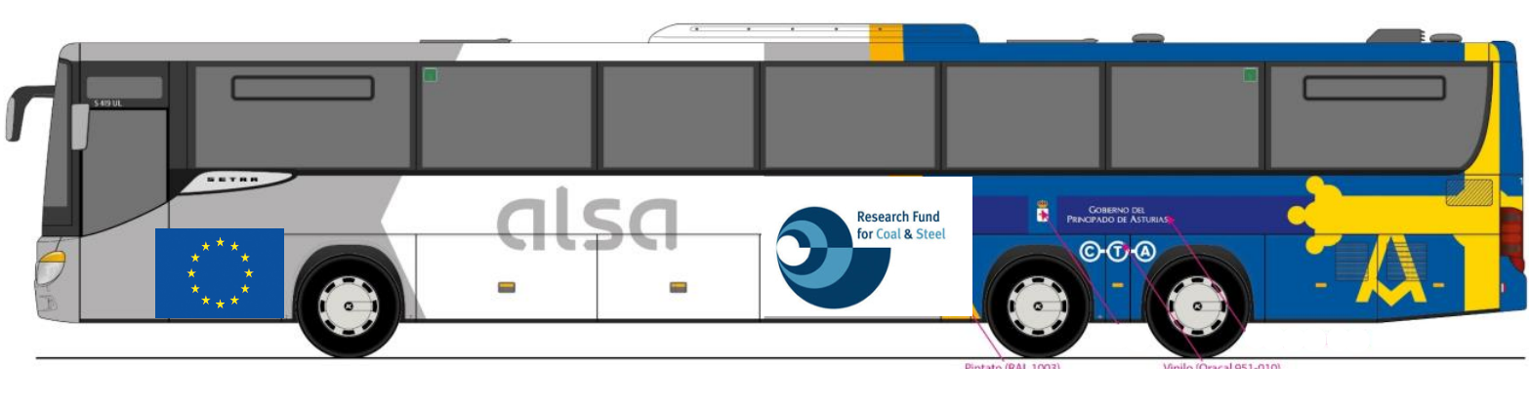
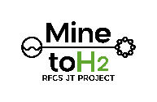
Main industrial and/or socio-economic outcome/ impact
Hydrogen and its coupling with the heating sector will support the just transition of the coal sector and regions promoting sustainable local economic growth and maximising the number of green and quality jobs.
Depending on the downstream natural gas customers, demonstrating the hydrogen admissibility level of the different equipment.
Lower climate impact in passenger transport.
Notes:
Scientific breakthrough; approval of a (new) standard creating/ enabling new economic activities, i.e. becoming “the” standard in a given sector; result/ solution becoming a social, workplace, business innovation (Innovation (europa.eu)); EU, national or regional institutions or NGOs supporting/ promoting the result/ solution; application of result/ solution in other economic/ technical/ societal environments (“out of the box” thinking); large number of users; gathering private investments/ financing for the further development including market deployment; etc.

Slide 10
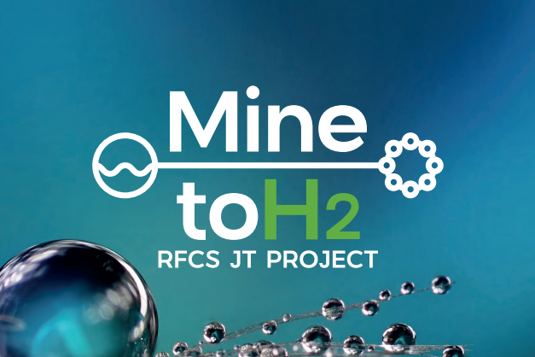
Communication & dissemination
Reaching multiple audiences to maximise stakeholders’ involvement: coal mining companies, EURACOAL, UNECE, & associations related with H₂.
With the help of adequate initiatives: a friendly website; annual newsletters; promotional videos; presentations at relevant forums; publications; etc.
Benchmarking of coal mining companies focusing on the feasibility of building green hydrogen plants to undergo their repurposing.
Training managers from coal mines on this business plan.
And taking further steps once the project is completed: feeding back new policy-making, scaling up production if feasible, etc.

Slide 11
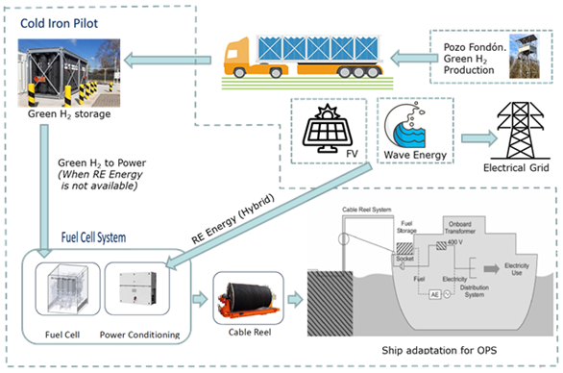
Exploitation
Contacting potential off-takers: regional and national bus fleets, urban bus fleets, waste management fleets, retail and logistic fleets, industrial plants and others.
Exploring further pilots trying to involve other possible stakeholders, e.g., Onshore power supply (OPS).

Slide 12
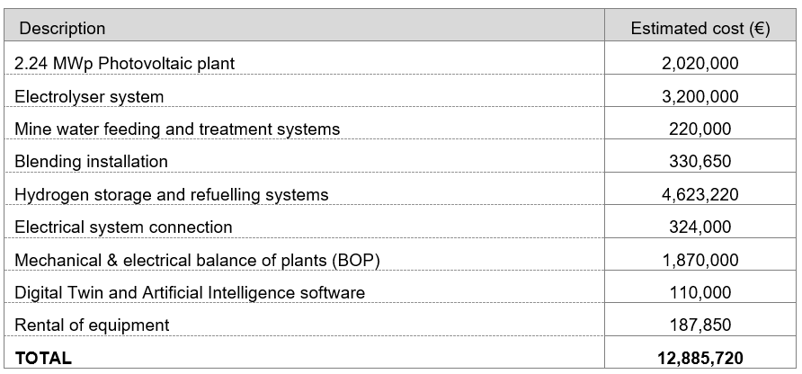
Economics behind the project
Capital expense (CAPEX)

Slide 13
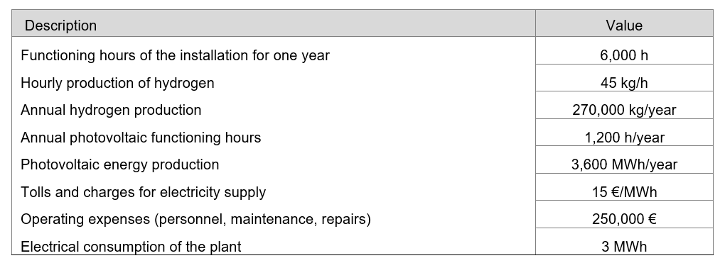
Economics behind the project
Technical and economic parameters

Slide 14
Challenges
  Beneficiaries
  New use for mine water
  Synergies with other European Projects
  Heat recovery and integration into DH networks
  Recovery of mining areas
  Development of new technologies

Slide 15
Beneficiaries
Extensive experience in RFCS projects
(Coordinator in Potentials, RECOVERY, GreenJOBS, etc.)
Already experienced in green H2
Large Companies but strong link to this coal region

Slide 16
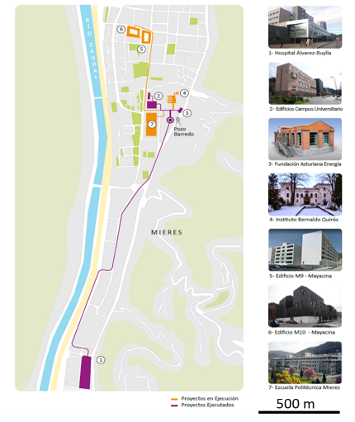
New use for mine water
Mine water pumped yearly: 35 Hm3/y (1 m3/s)
Temperature: 23ºC
Used to generate heating and cooling service with the help of chillers and heat pumps.
1. BARREDO COLLIERY (6,6 +3,6 MWth) in Mieres
First geotermal
facilities (2014):
4,6 MWth + 3,6 MWth
(heating + cooling)
New Barredo District
Heating Network (2020):
2 MWth
(Heating)

Slide 17
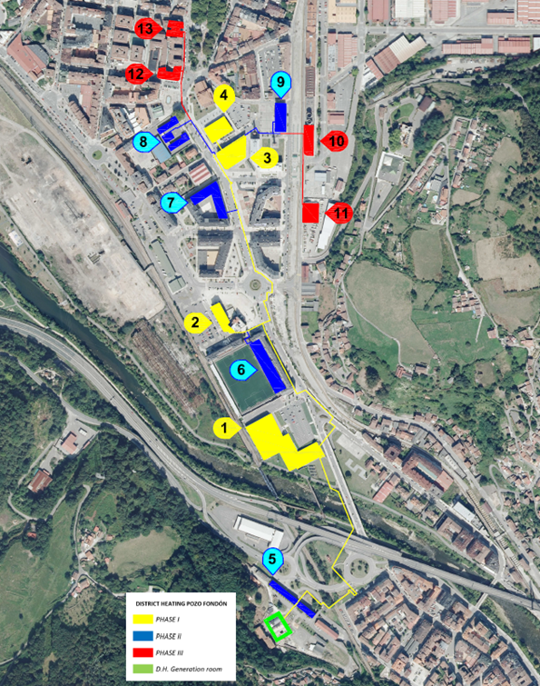
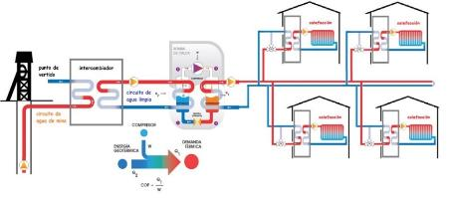

New use for mine water
1. FONDÓN COLLIERY (1,5 +1,5 MWth) (Langreo)
DH Fondón
Phase I (2022):
1,5 MWth
DH Fondón Phase II:
(hybridization with biomass - under construction)
1,5 MWth

Slide 18




Synergies with other European projects
Recent case studies in R&D European projects.
REWARDHeat
(2019-2024)
Recovery of waste heat from electrolyzers for use in district heating networks.
Assessment of the feasibility of implementing green hydrogen generation plants, mainly in mining areas.
GreenJOBS
(2022-2025)
Opportunity: - Efficiency of PEM electrolysis is approximately 70%
- Heat losses usable in our District heating Networks

Slide 19
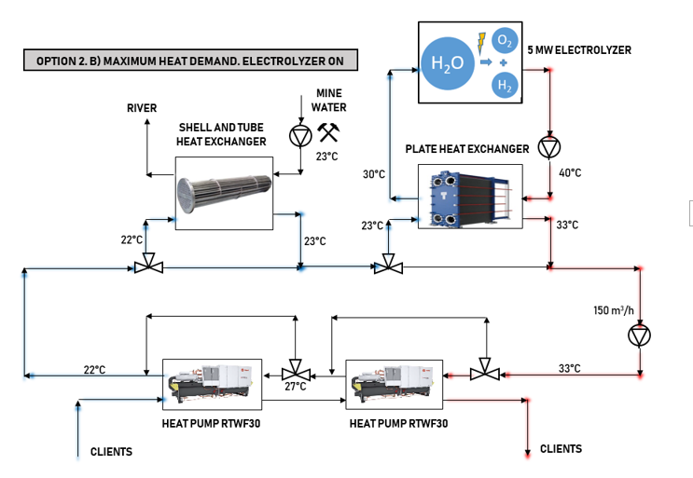
Heat recovery
Cooling temperatures up to 30-40°.
Very high efficiency for space heating and DHW through the use of water-to-water chillers or heat pumps.
27%

Slide 20
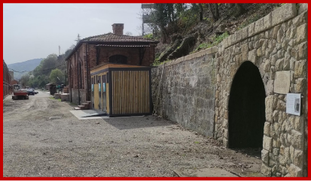
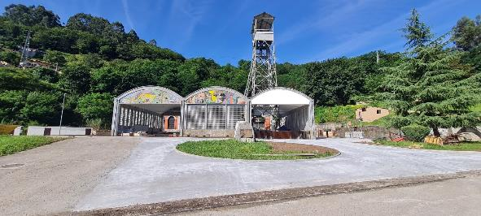
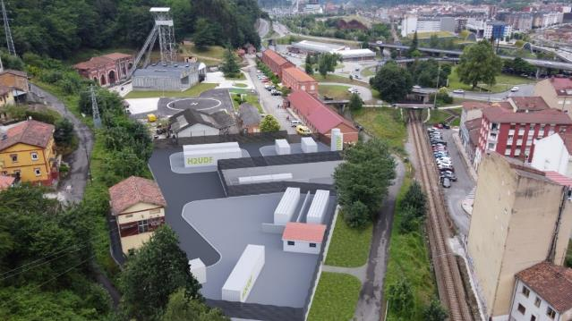
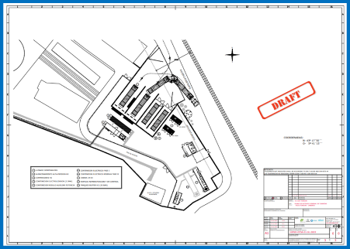
Recovery of mining areas
Water from La Nalona (former coal mine)
2.5 MW electrolyzer stack

Slide 21
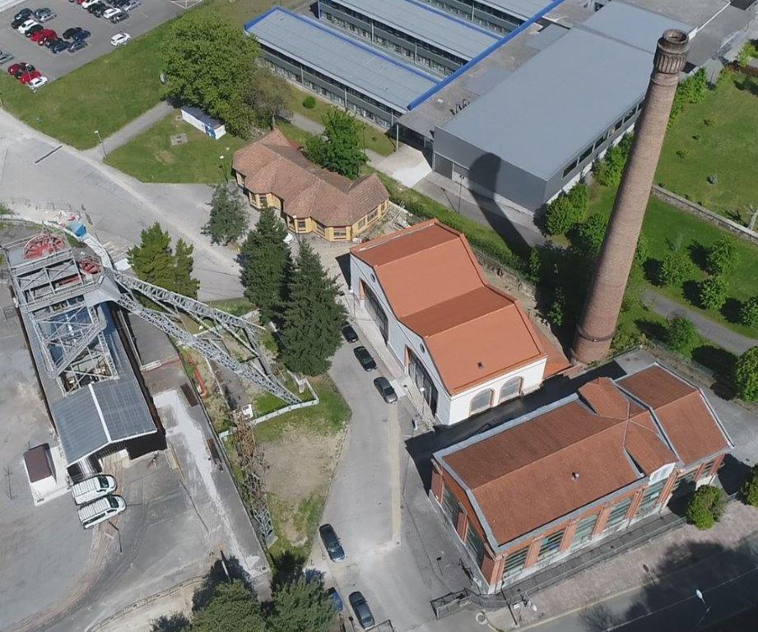
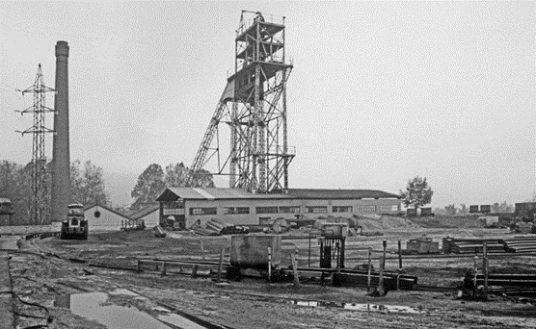

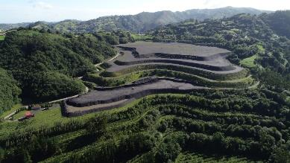
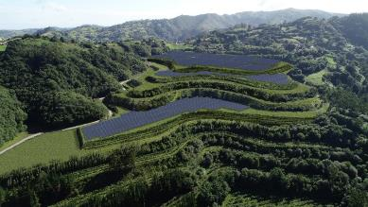
Recovery of mining areas
From Colliery to Industrial Plant
Open Pit or Waste Dump to PV Plant
Restoration
Resource utilization

Slide 22
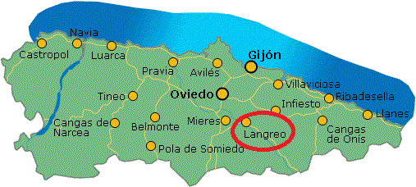
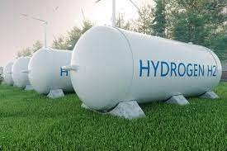

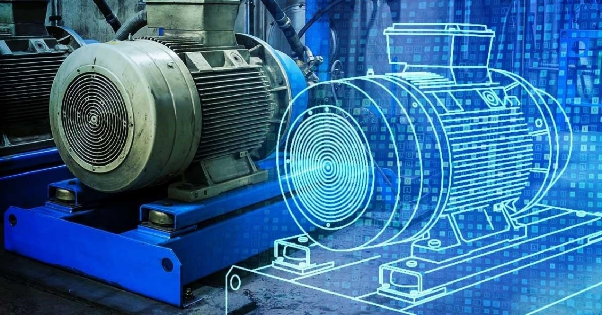
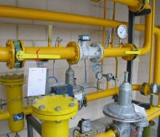
Development of technologies
GREEN
MOBILITY:
First FCEV
Intercity
H2 STORAGE
500 bar
BLENDING
Testing
Limits ¿?
DIGITAL
TWIN

Slide 23
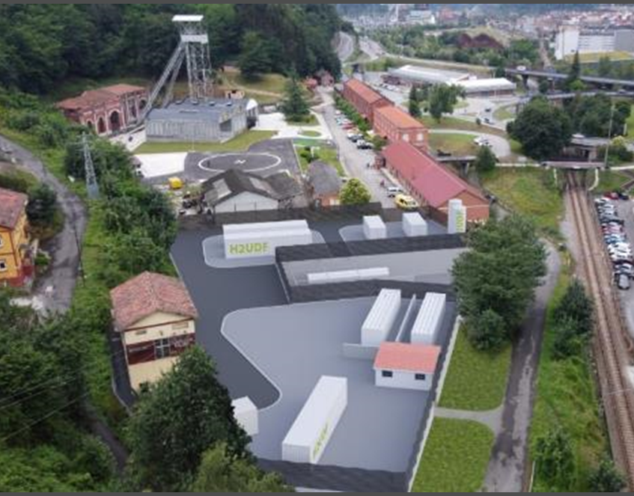
Conclusions
SYNERGIES:
Other EU projects
Beneficiaries
NEW TECHNOLOGY
DEVELOPMENTS:
Intercity bus
Blending
H2 Storage
Digital Twin
RECOVERY OF
MINING AREAS:
Collieries
Open Pit Mines
CIRCULAR ECONOMY:
Mine water
Heat recovery

Slide 24

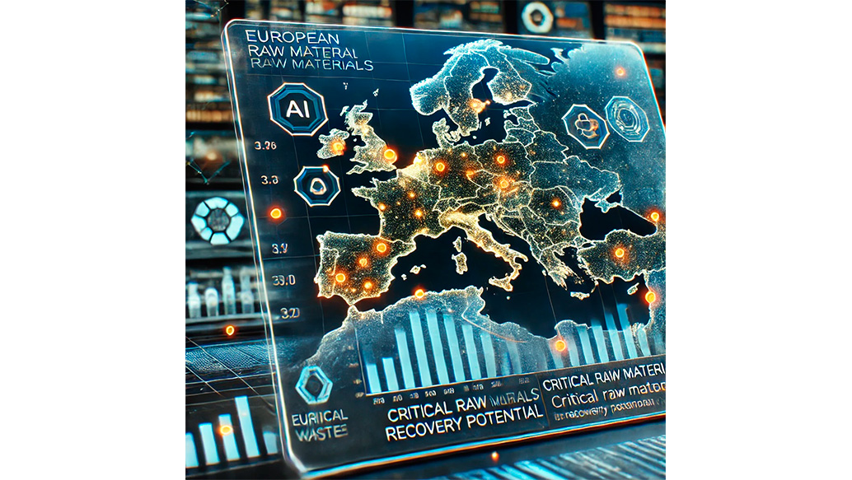
Where are we going?
CRMsDataSpace project aims to develop a Common European Data Space on Critical Raw Materials (CRMs) for the Green Deal, with a primary focus on recovering critical raw materials from closed extractive coal waste facilities.
Main goals:
1.- Creating a Centralized Digital Data Space
2.- Enhancing CRM Recovery through AI & Data Technologies
3.- Reducing Europe’s Dependency on CRM Imports
4.- Supporting the European Green Deal & Critical Raw Materials Act.

Slide 25
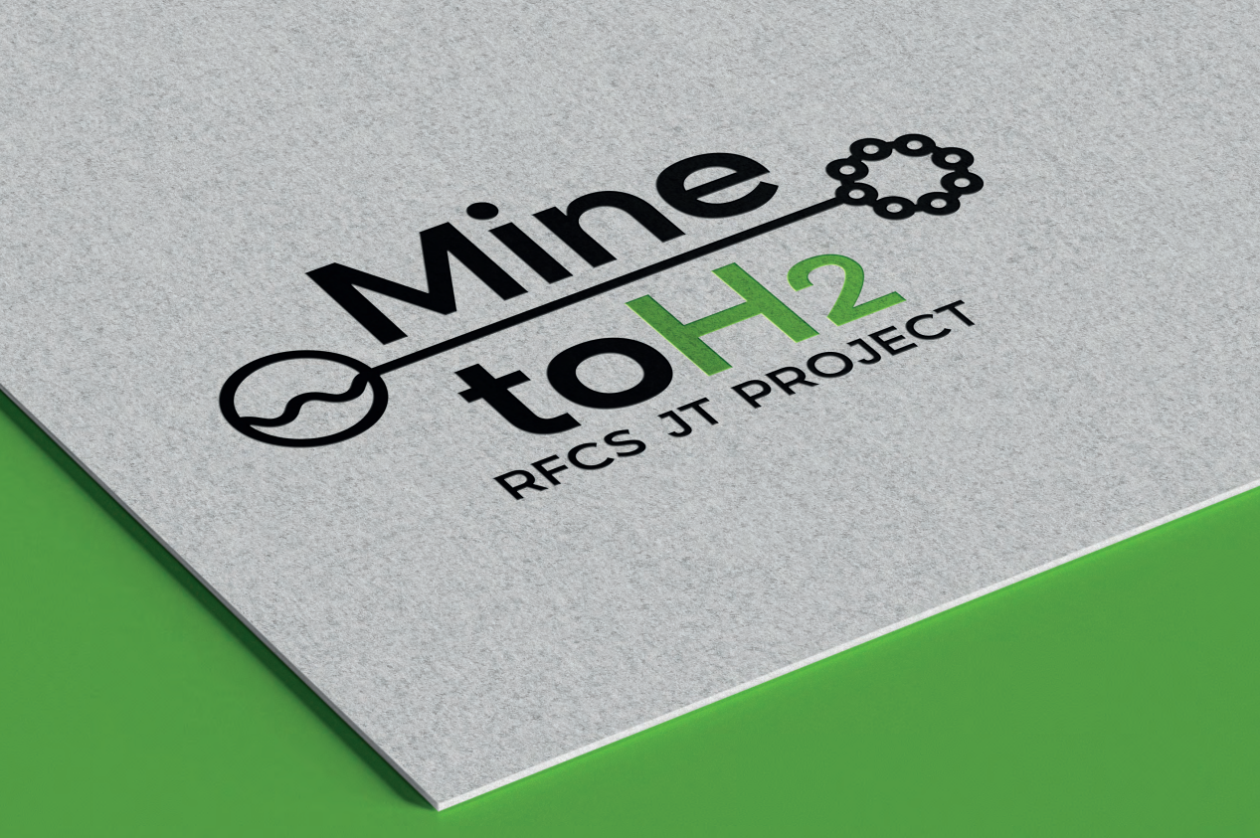
Thank you very much for your attention
www.minetoh2project.eu

